Slide 1
Welcome to Python (Hybrid) (S25)

Slide 2
Agenda
Introductions (10 min) 👋
Course overview, goals 🎯
(Very Brief) Intro to Python 🐍
Install Python, VSCode, git 💻
Semester kick-off 🎉

Slide 3

Introductions
Notes:
https://teambuilding.com/blog/icebreaker-games-for-adults
https://toolbox.hyperisland.com/

Slide 4
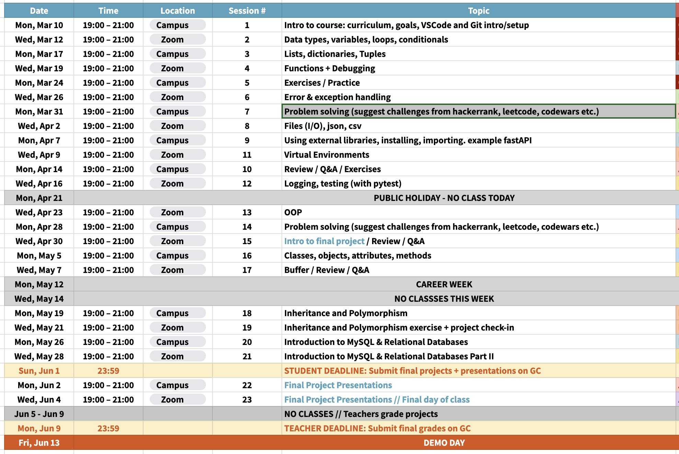
A look at this semester

Slide 5

In this course, you will learn how to…
Use Python to solve problems with fundamental building blocks such as conditionals, loops, functions, and basic data structures
Communicate intent of your code with classes, errors, context managers
Keep code manageable with naming, comments, testing, debugging
Organize and reuse code with git, GitHub, pip, pypi
Set up IDEs such as Visual Studio Code to make it easier to write code

Slide 6

How to be successful
Come to class and participate
  Follow along on your own device during demos
  Ask and answer questions
  Do the exercises and homework
  For online class, cameras ON (or you will be marked as absent)
Submit a final project (details will come later in the semester)
Engage with Career Services
  Attend 2 workshops
  Complete 1 recommended module on the IBM SkillsBuild
  See learner hub for details

Slide 7

Python intro

Slide 8
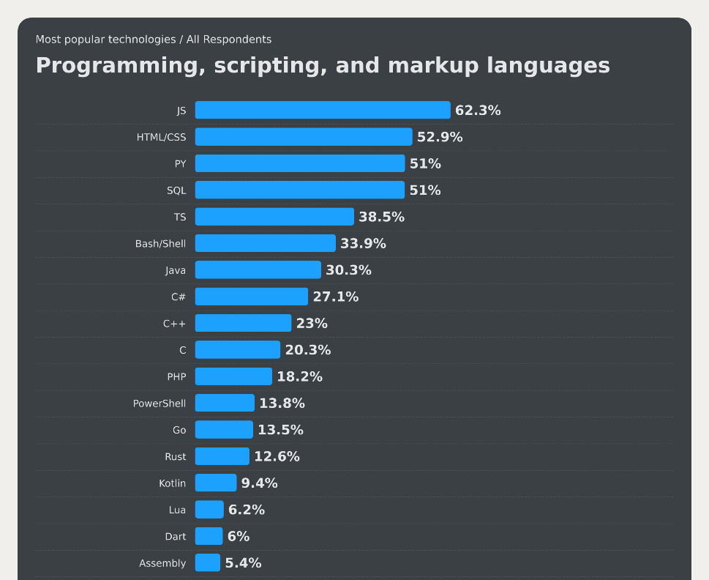
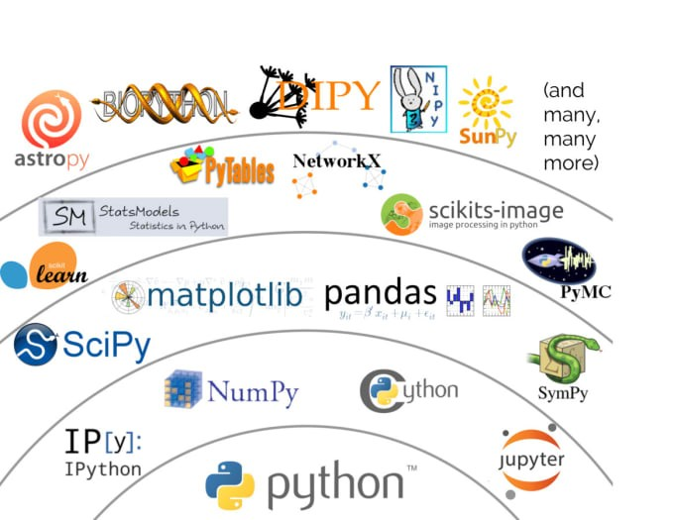
Why python?
Easy to learn
Relevant in industry
Many external libraries

Slide 9
How to install Python
https://www.python.org/downloads/windows/

Slide 10
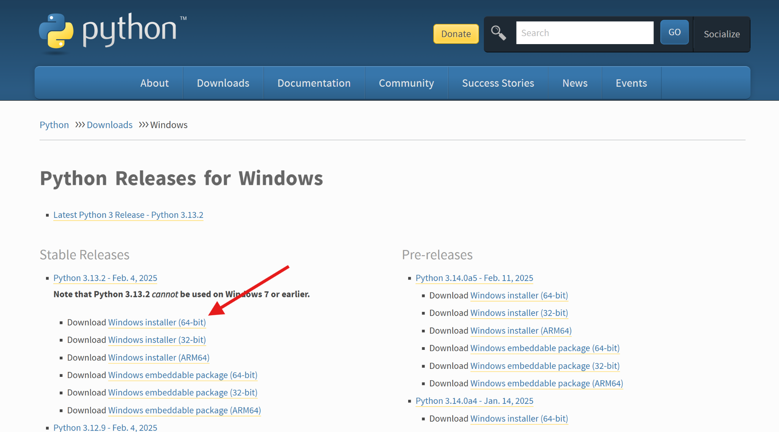

Slide 11
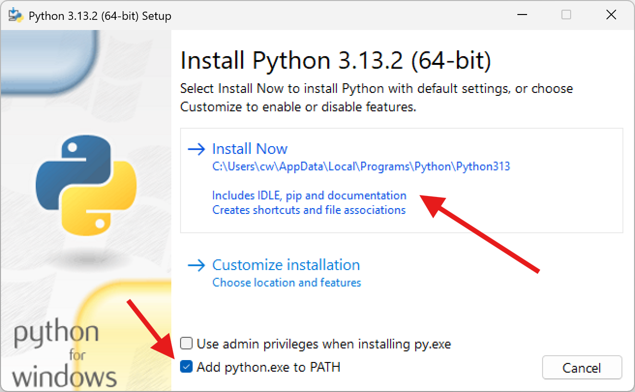

Slide 12
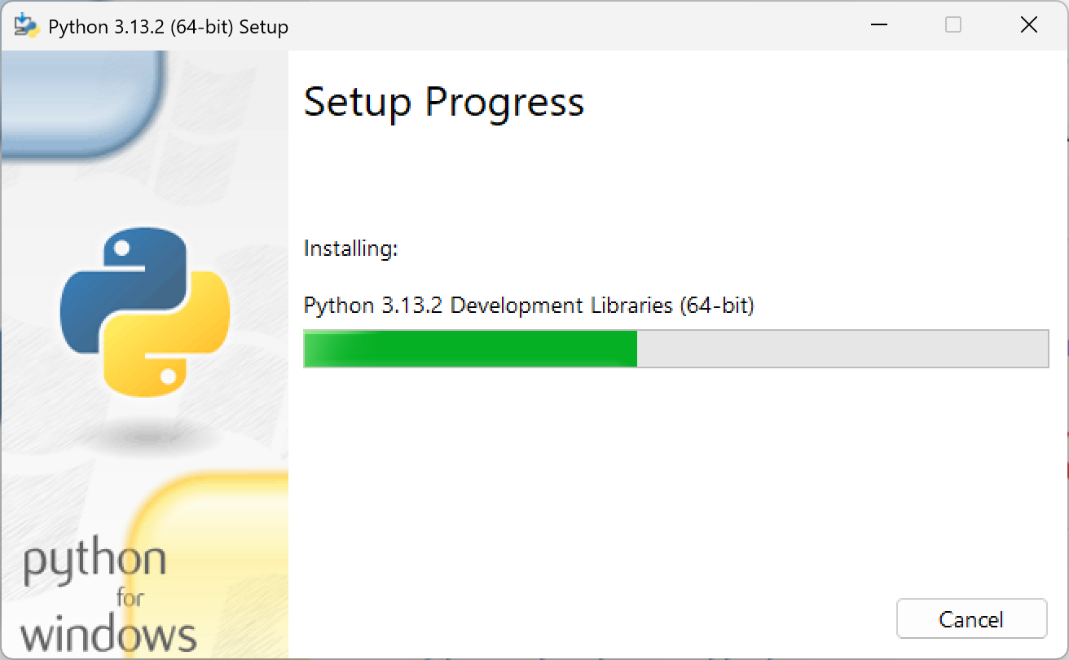

Slide 13
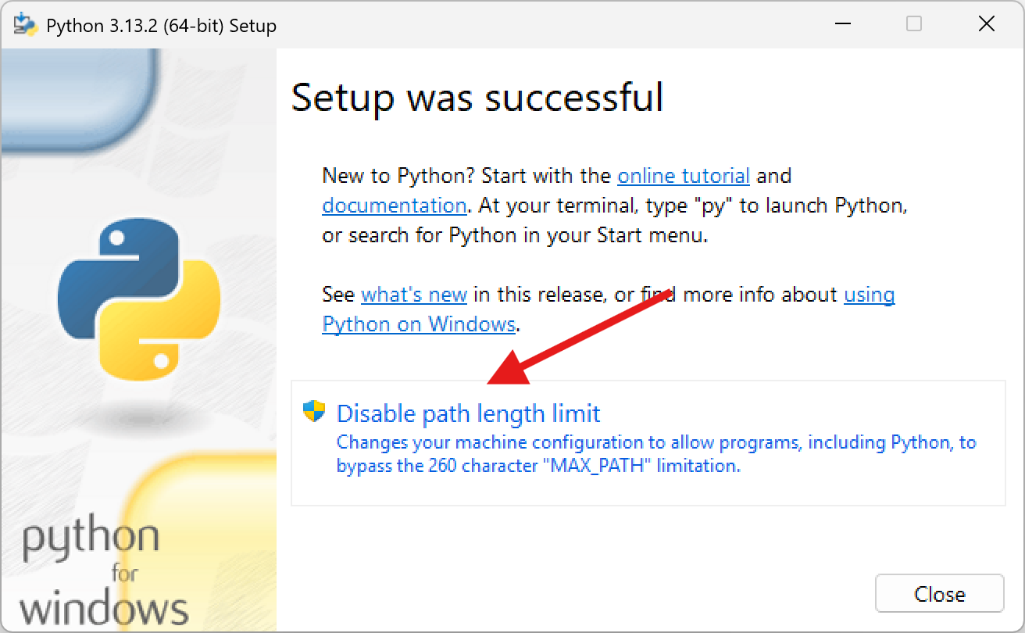

Slide 14
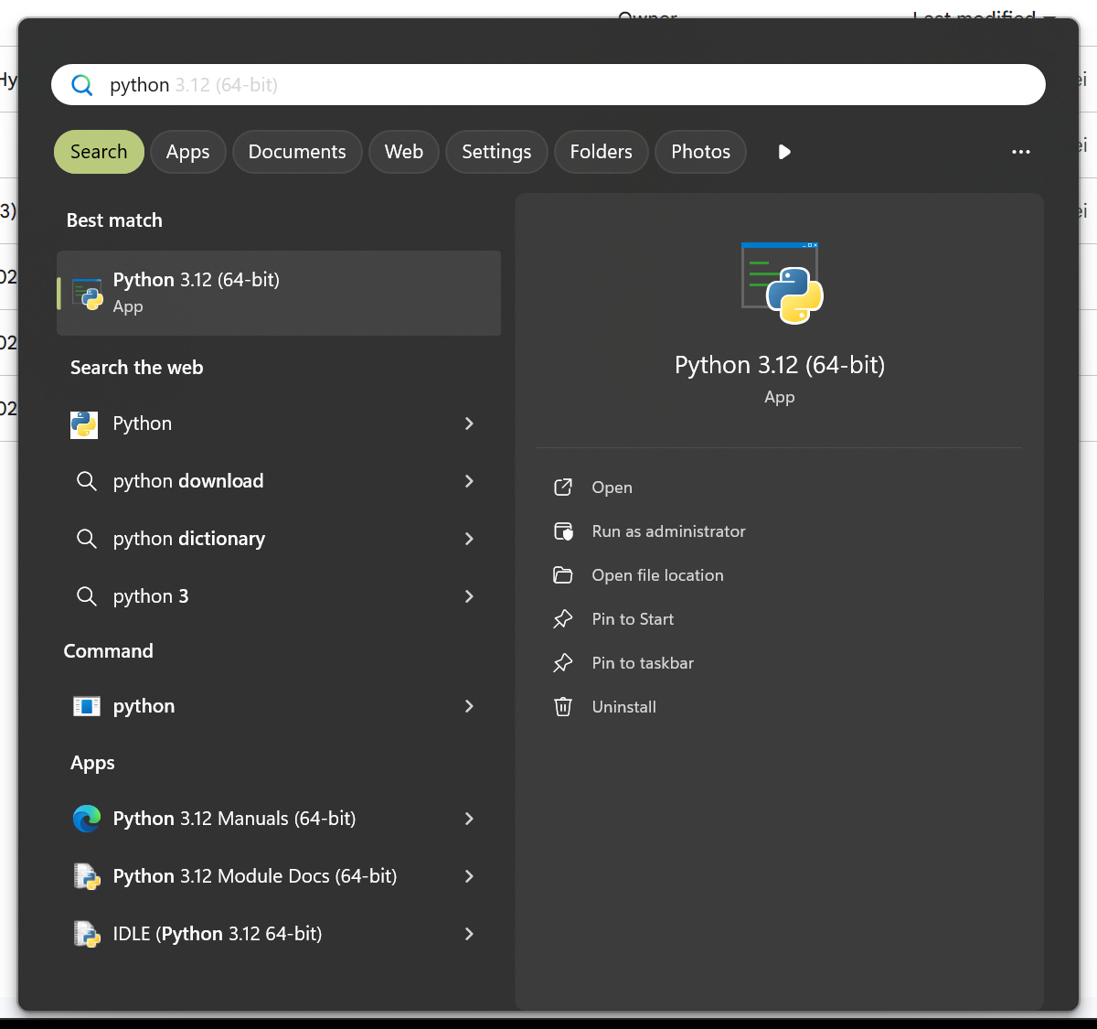
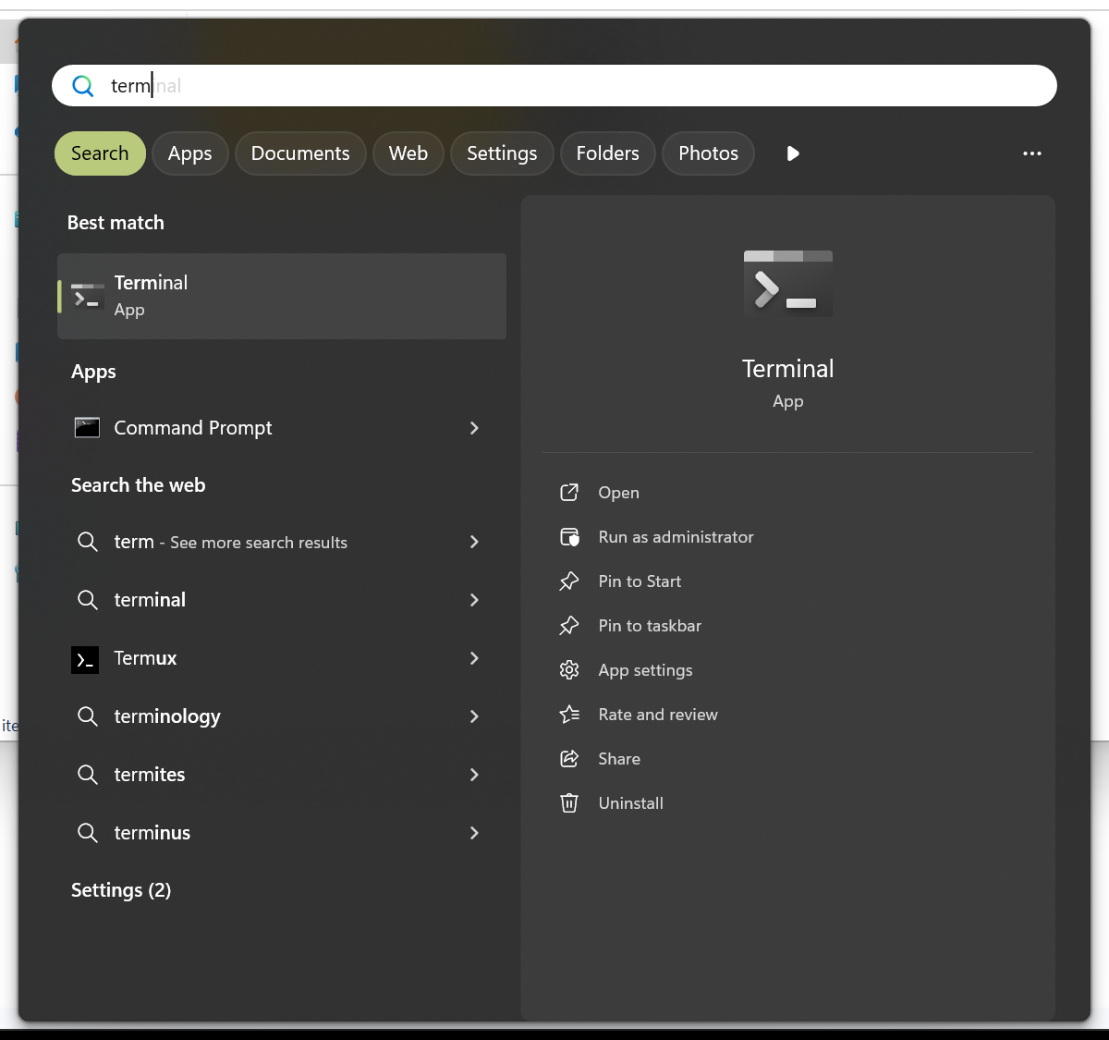
How to "run" Python
Python
Terminal / Powershell / Command Line / Bash

Slide 15
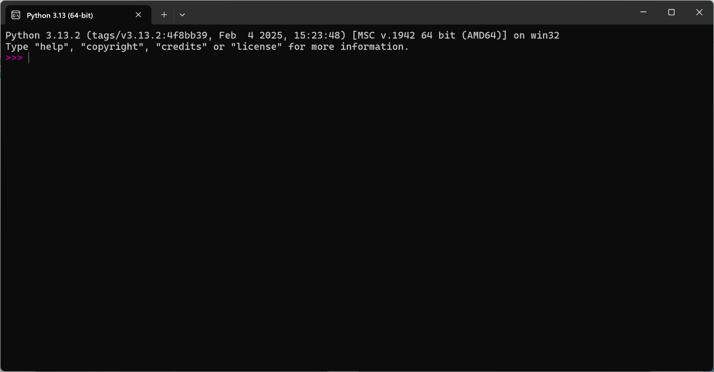
How to "run" Python

Slide 16
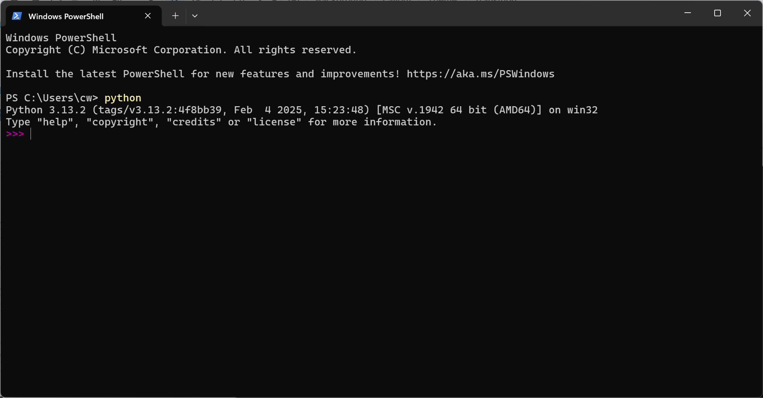
Terminal / Powershell / Command

Slide 17
How to "run" Python
This is a Python REPL (Read, Evaluate, Print, Loop)
All code that you write here is temporary, valid only while this application is open. Great for experimentation!
Conversely, a Python script / project / module is code that persists somewhere on a machine (your PC, GitHub, PyPi)

Slide 18
Part 1:
Basic Statements

Slide 19
Basic Python statements
Enter these into your Python REPL.
Lines starting with >>> indicate examples you can type into your REPL (mirroring what you see on your REPL with >>>).
>>> 1 + 1
2
>>> 4 - 2
2
>>> 1800 * 2
3600
Notes:
Teacher: explain what is happening in each example, e.g. 1 is a number, + is an math operator, and typing 1 + 1 into the repl and hitting enter will show you the result of the statement

Slide 20
Basic Python statements
>>> 10 / 2
5.0
>>> 10 / 3
3.3333333333333335
>>> 3 ** 2
9
Notes:
Explain operator syntax, especially power **

Slide 21
Basic Python statements
>>> "hello"
'hello'
>>> "hello" + "world"
'helloworld'
>>> "hello " * 3
'hello hello hello '
>>> "hello" + 1
???
Notes:
For the last example, explain the concept of errors, but don't go into details of error handling. Just explain errors are when the software is giving you feedback that something is wrong. It is not necessarily "bad" to get errors.
TypeError is also a good segue to go into the concept of types in Python.

Slide 22
Basic Python statements
>>> type("hello")
<class 'str'>
>>> len("hello")
5
>>> "hello".upper()
'HELLO'
Notes:
Explain what does each statement do, both syntactically (e.g. we are calling a function called type on the text "hello", where "hello" is an input) and semantically (we are trying to get the type of the text "hello").
Briefly explain functions, e.g. they are like mathematical functions f(x), where they have an input, output, and do something to them.
Explain the difference between function and methods as simply as possible, as visible here, e.g. one is called on an input "hello", and one is a function attached to the value itself, which typically has the value as an initial input.
Feel free to defer explaining types later or here.

Slide 23
Basic Python statements
When you are done with your REPL and want to reset the environment
>>> exit()

Slide 24
Part 2: Determine types

Slide 25
Exercise: What’s the type of these objects?
2
2.3
2+2.3
"hello world"
'hello world'
"hello" + "world"
"2"
print("hi")
None
min(0.2, 1)
max(0.2, 1)
min("cba")
input("Enter your name:")
input()
REMEMBER THAT
0. In python, everything is an object.
1. Every object has a type.
type(2)
type(“hello”)
type(None)
type(print)
2. Every function returns an object.
x = min(2,9)
x = print(“hello”)
type(x)
OR: type(print(“hello”))

Slide 26
Part 3:
Use external libraries

Slide 27
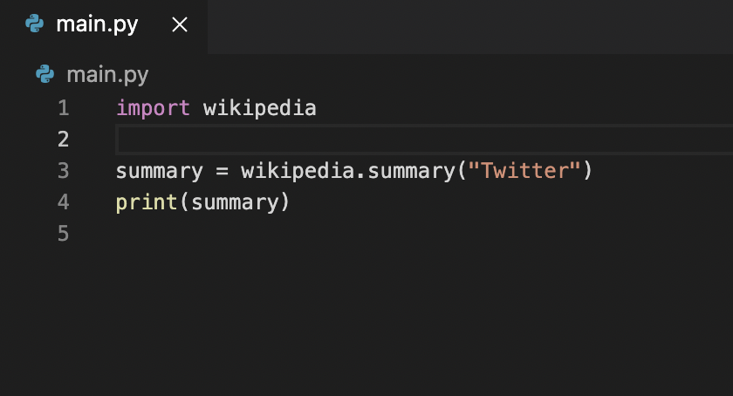
VSCode (teacher)
Import time
  time.time()
  time.time_ns()
  time.sleep(1)
Import turtle
  turtle.forward()
  …
Wikipedia
  pip install wikipedia
  import wikipedia
  wikipedia.summary(“Python language”)
Notes:
Metaphor of modules like a library, and importing them is asking python to find and open a book on your desk (current working script)

Slide 28
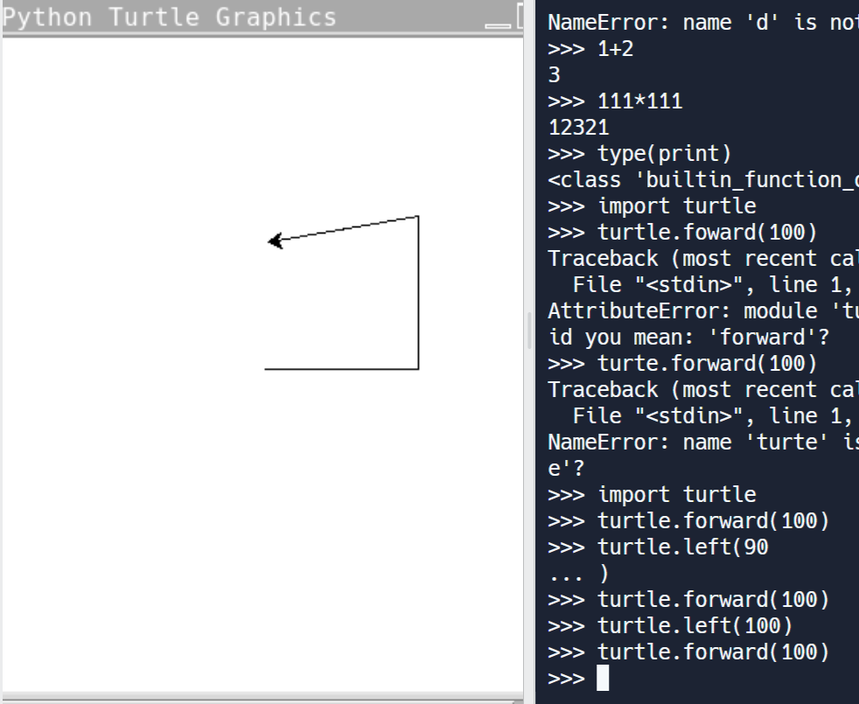
Exercise: draw a square with the turtle!
(or a more complex form)
REMEMBER THAT
import turtle
turtle.forward(...)
turtle.left(...)
turtle.right(...)
turtle.reset(...)

Slide 29

There are 552,735 python libraries to …
… read data from various sources:
  Keyboard, mouse, joystick, …
  Files (images, music files, text files, …)
  Email, web pages
  Temperature sensor
  …
… export python data:
  Text / Images to monitor (videos, games)
  Sound to headphones
  Messages (SMS, whatsapp, twitter, …)
  Robot motors
  …
… manipulate data
READ WIKIPEDIA WEBPAGE
import wikipedia
wikipedia.summary(“Munich”)
SOMETHING LIKE
import robot
robot.move(100)

Slide 30
Part 4:
Write python files

Slide 31
let’s write code to a file (teacher)
In main.py
  x=1+2
  x
  print(x)
Execute file in two ways:
  Via shell and “python main.py”
  Via big green run button

Slide 32
Exercise: Write a program that…
Asks the users for his name
saves the name to a variable
Prints e.g. “good morning Christian!”
And “good evening Christian!”
Upload it to Github
REMEMBER THAT
input()
“Hello “ + “world”
print()

Slide 33
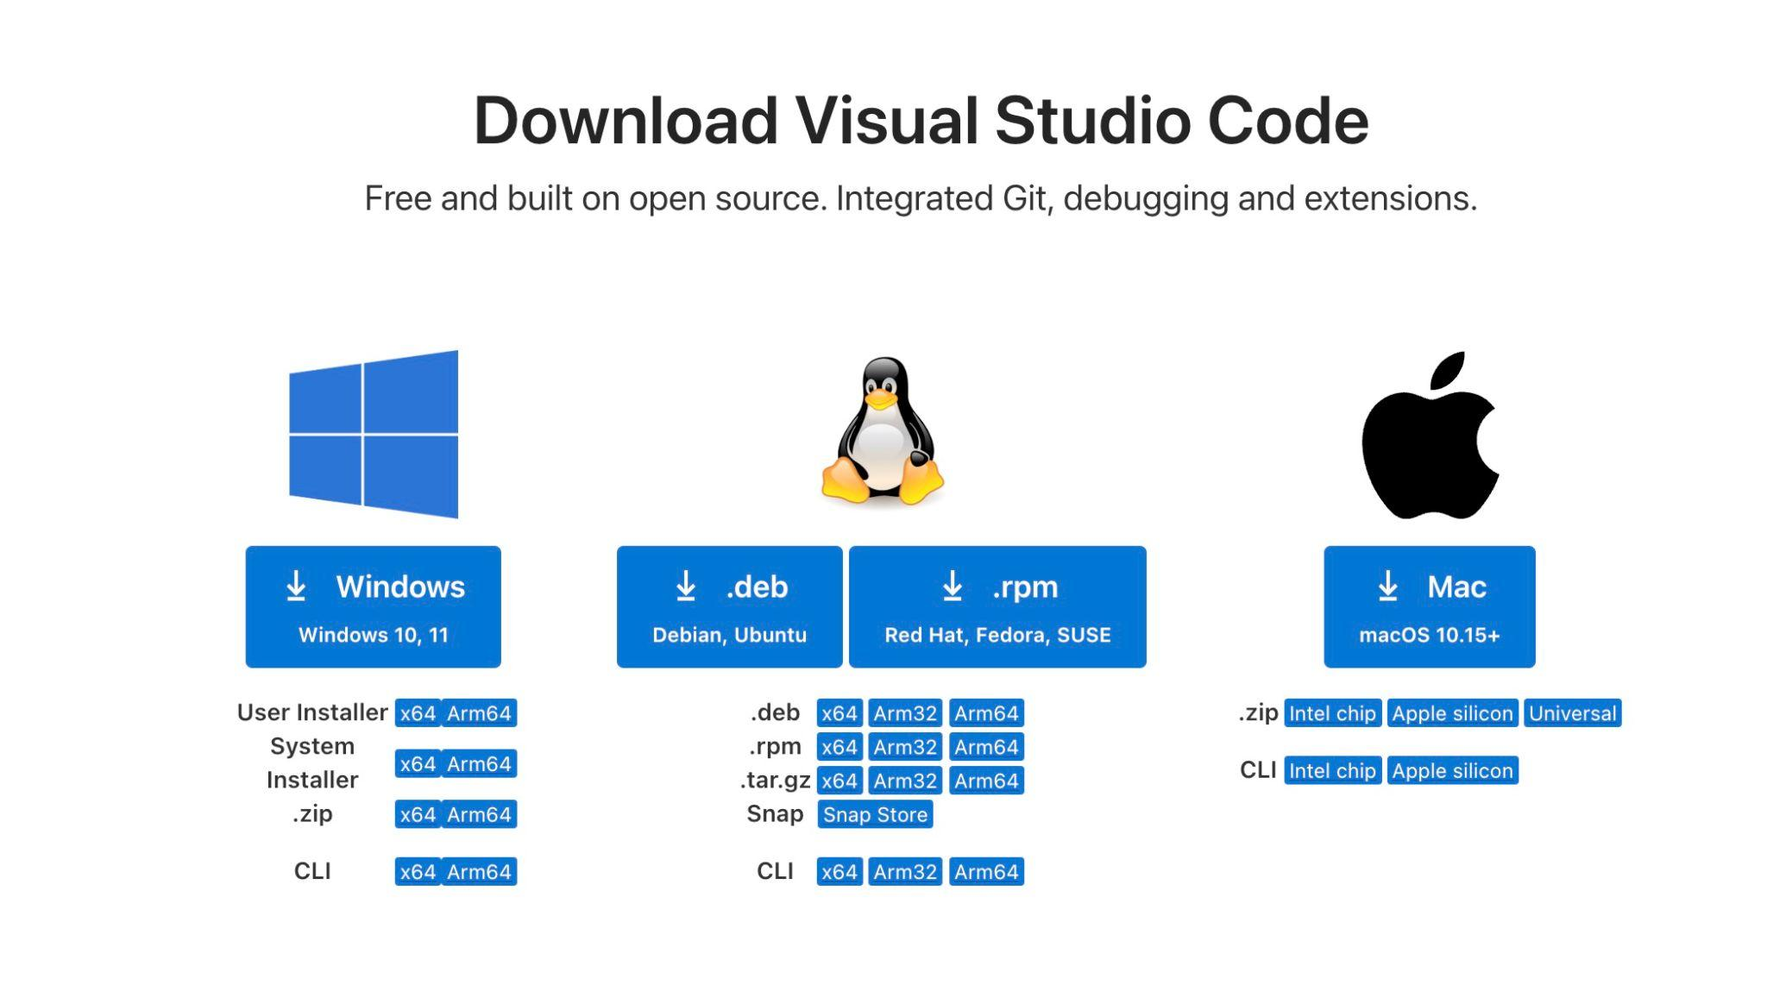
Setup and Installation
https://code.visualstudio.com/download

Slide 34
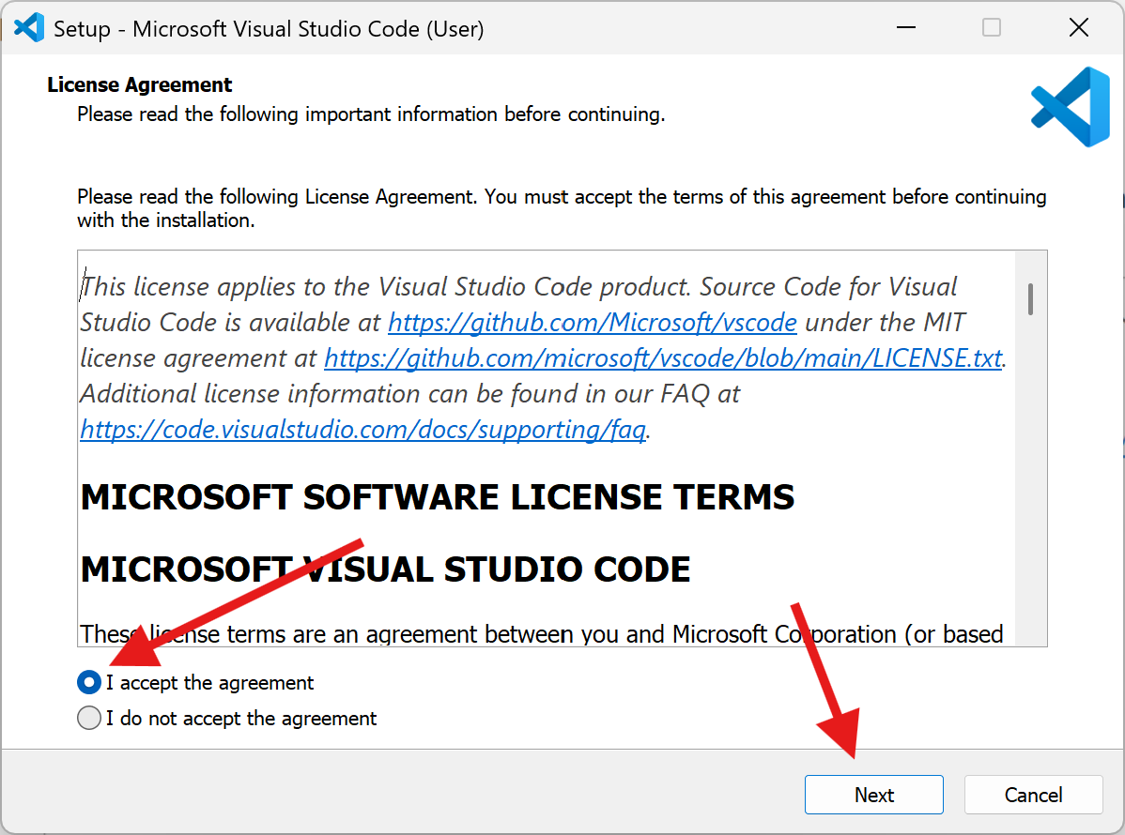

Slide 35
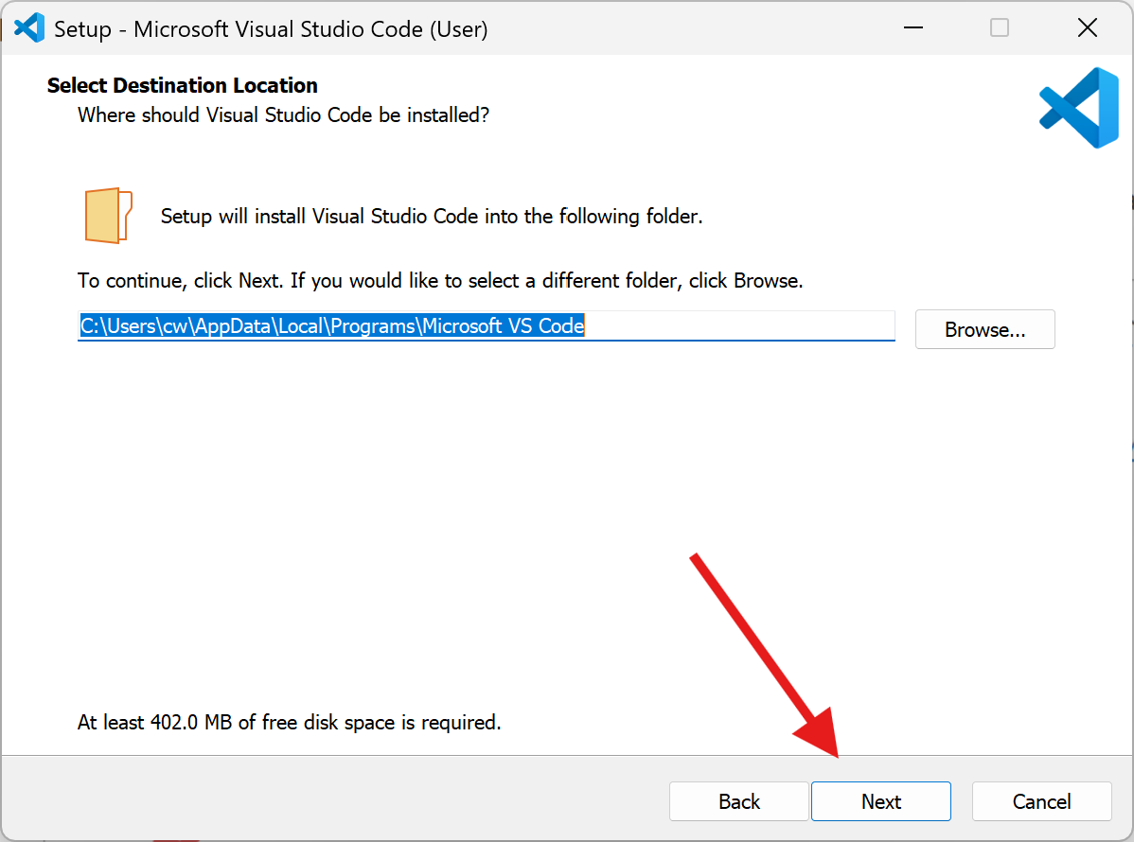

Slide 36
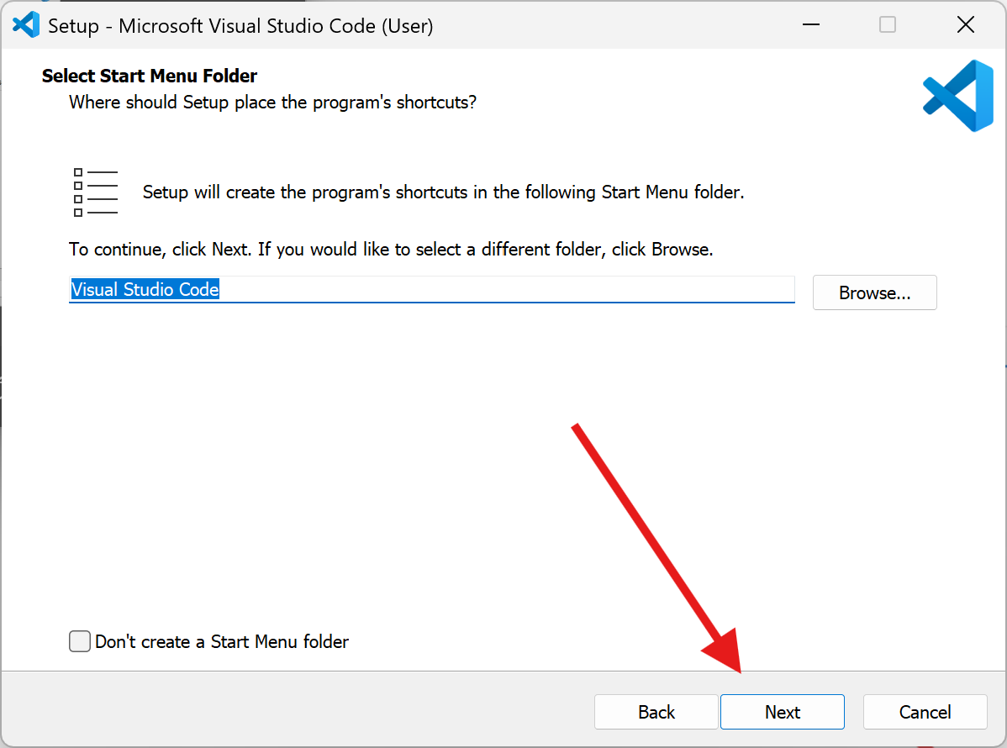

Slide 37
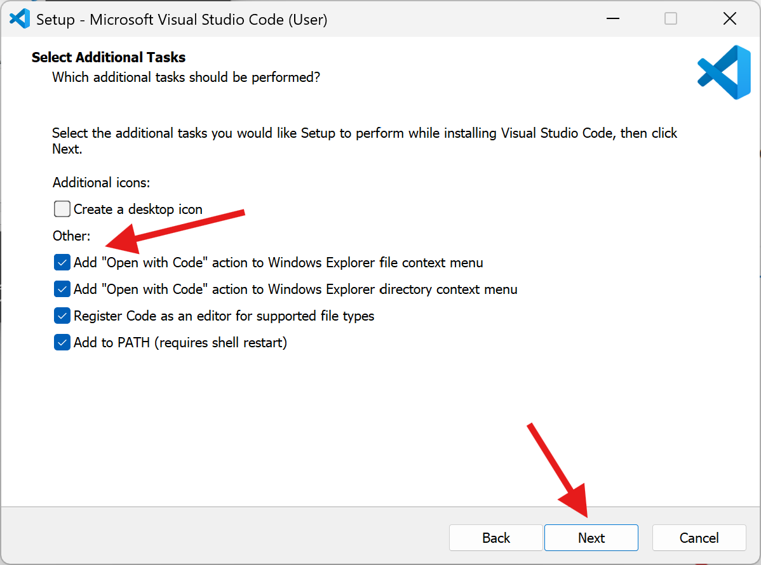

Slide 38
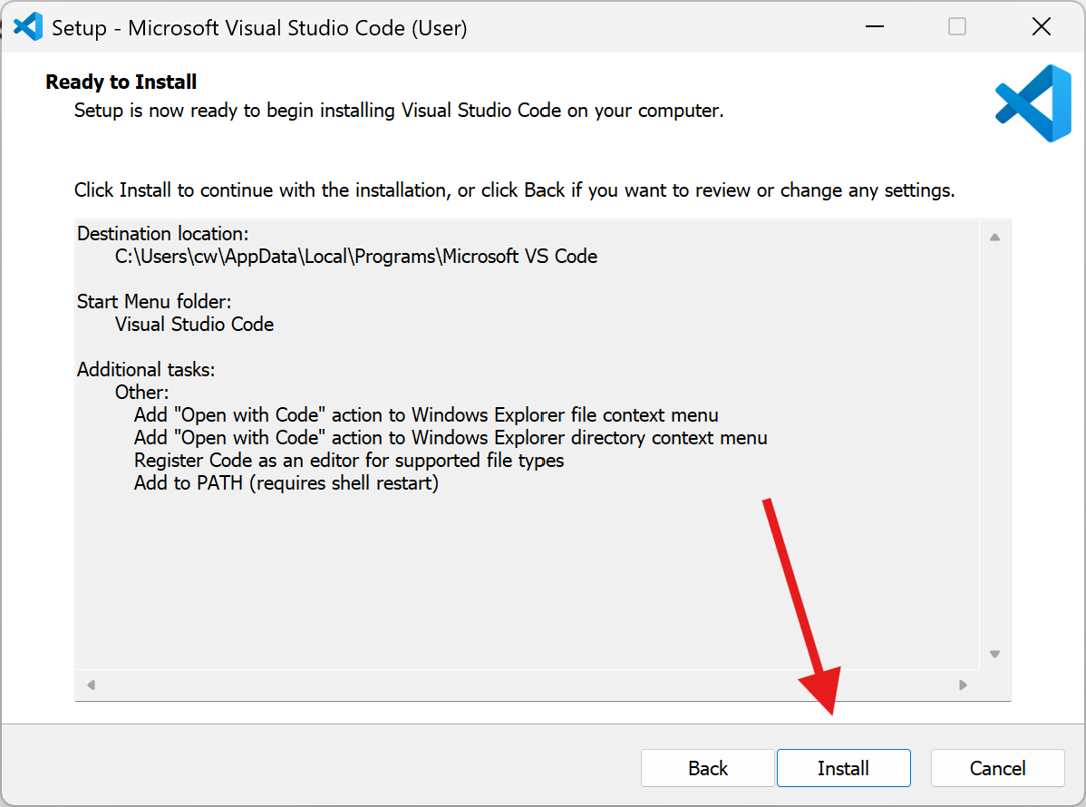

Slide 39
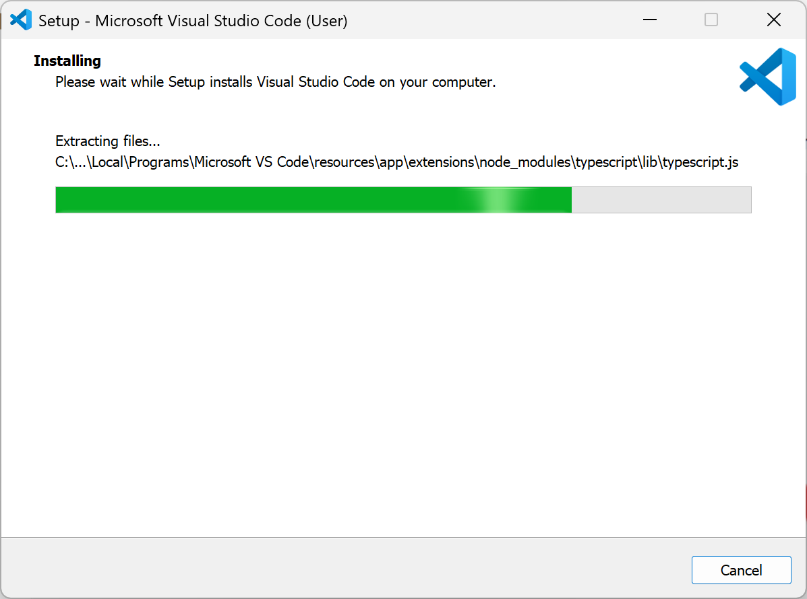

Slide 40
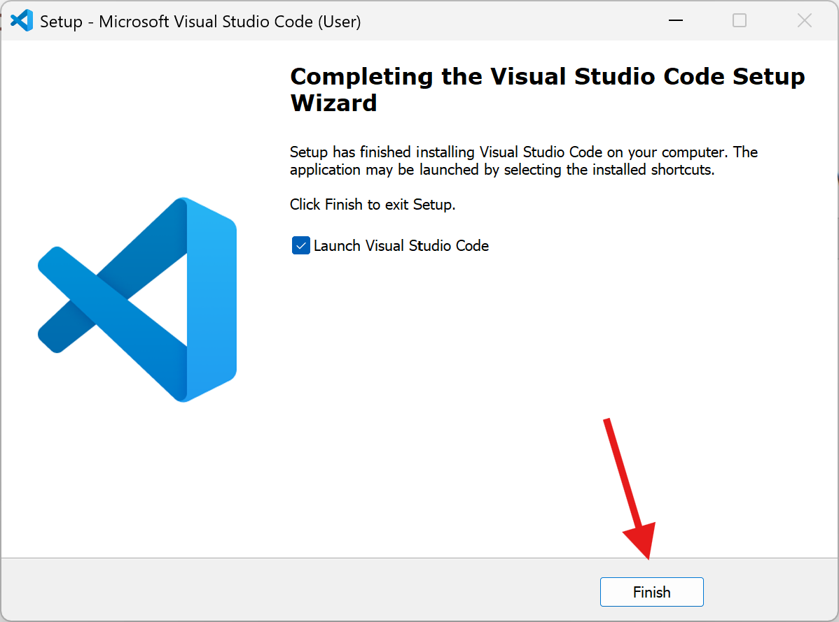

Slide 41
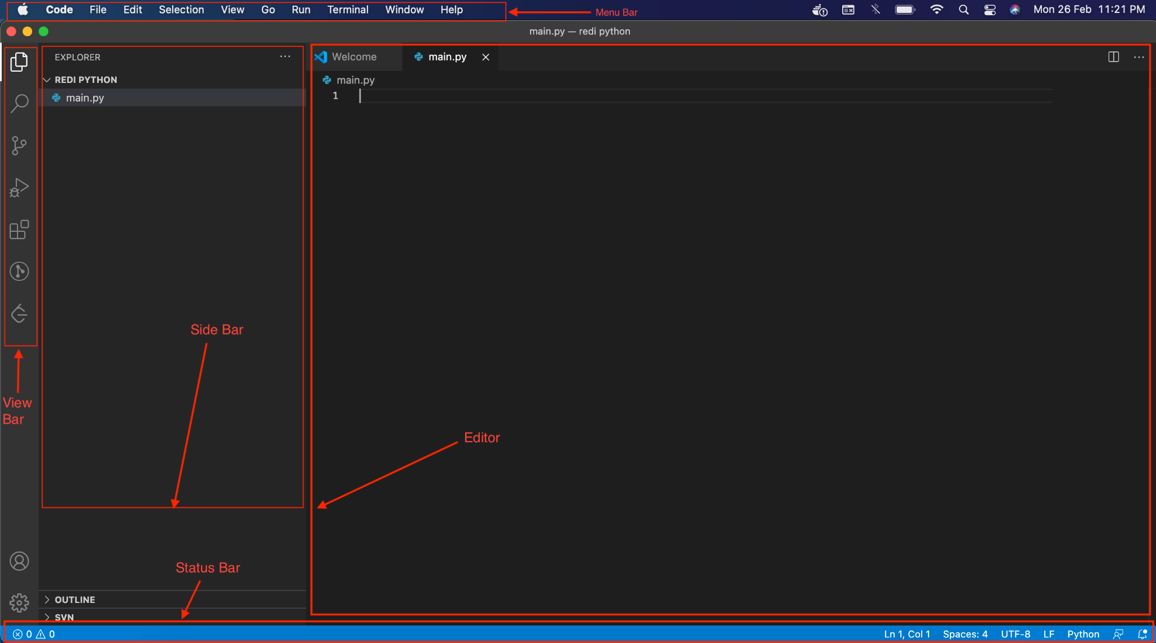
VS Code - Visual Studio Code

Slide 42
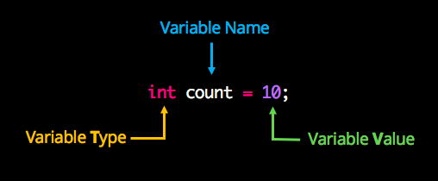
VSCode - let’s use (teacher)
calculator (1+2, 111*111, ...)
save objects “variable assignment” (x=2, x*5, day=”Monday”)
builtin functions
  min(...), max(...)
  print(...)
  input(...)
  type(...)
  exit(...)
Notes:
For python you can do:
```count: int = 10```

Slide 43
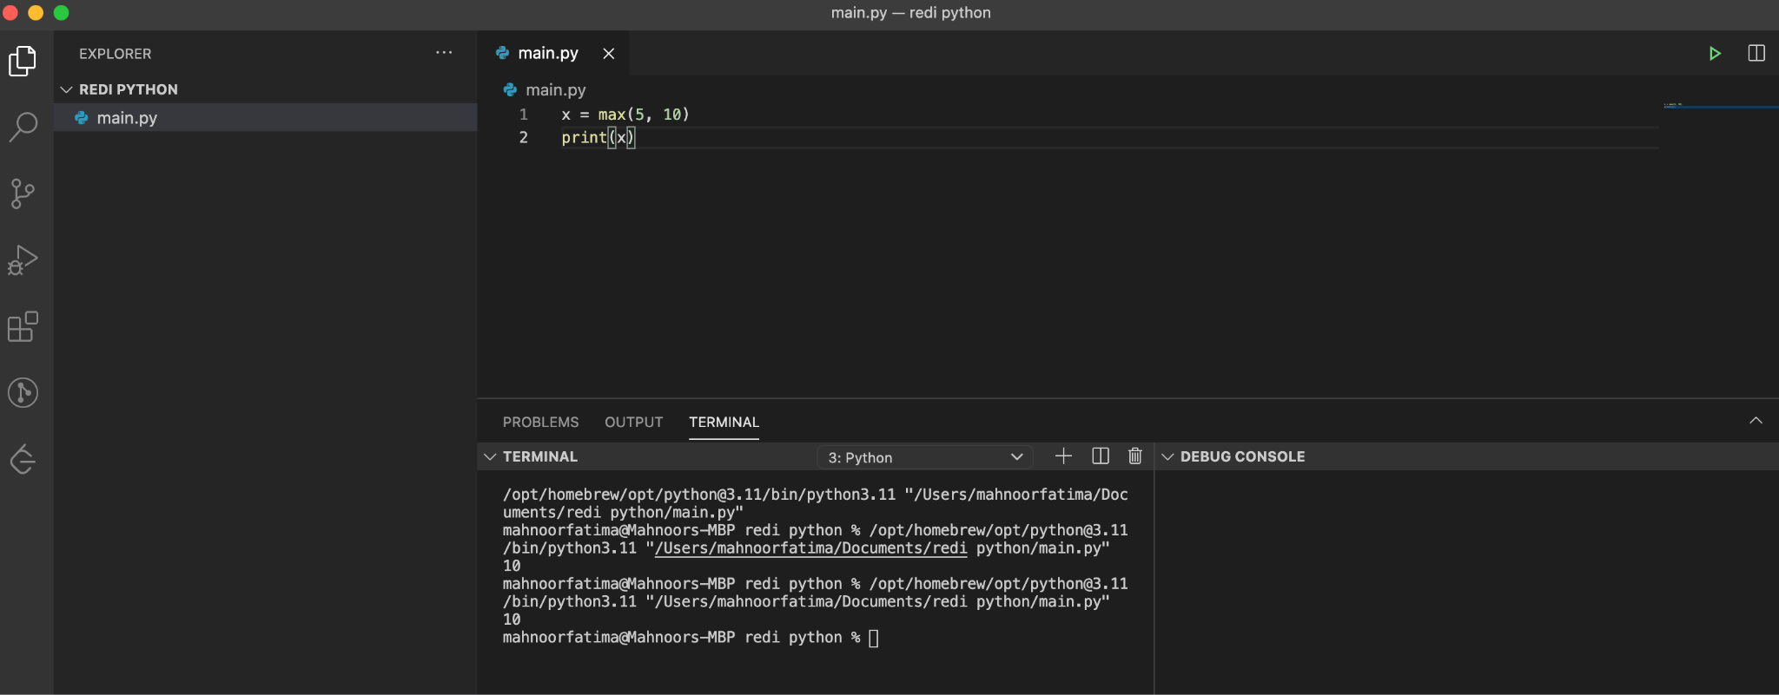
VSCode

Slide 44
git

Slide 45
Version Control Software
git is a type of software called Version Control Software (VCS)
Why do we want version control?
  Going back to a previous version of code, e.g. undoing a feature, changing your mind
  Working on a parallel version of your code, e.g. making multiple features at the same time but isolated!
  Working with multiple people at the same time
  Contextual information about changes to the code over time
    Which changes were made?
    Who made the changes?
    When were the changes made?
    Why were changes needed?
Many other VCS that are not git: mercurial, CVS, fossil, SVN

Slide 46
GitHub account
Notes:
Create / sign in to GitHub

Slide 47
git for windows
Notes:
Install git for windows

Slide 48
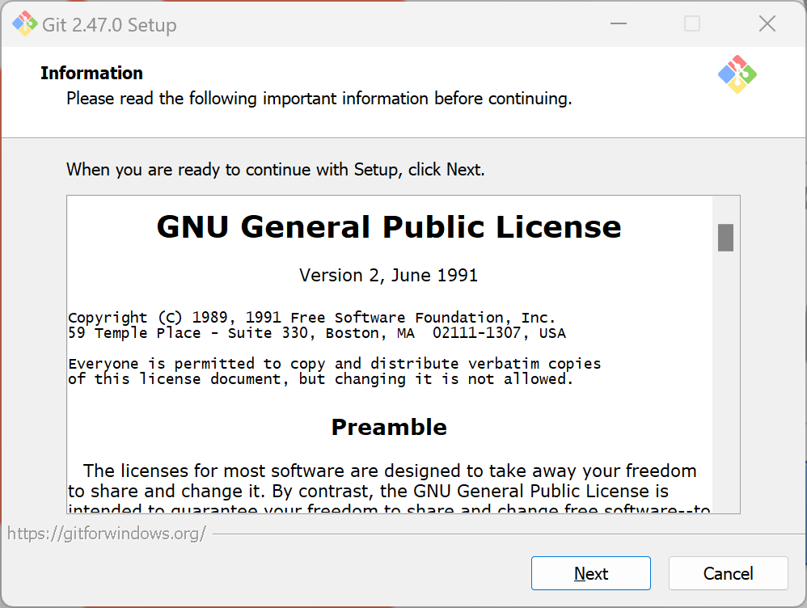

Slide 49
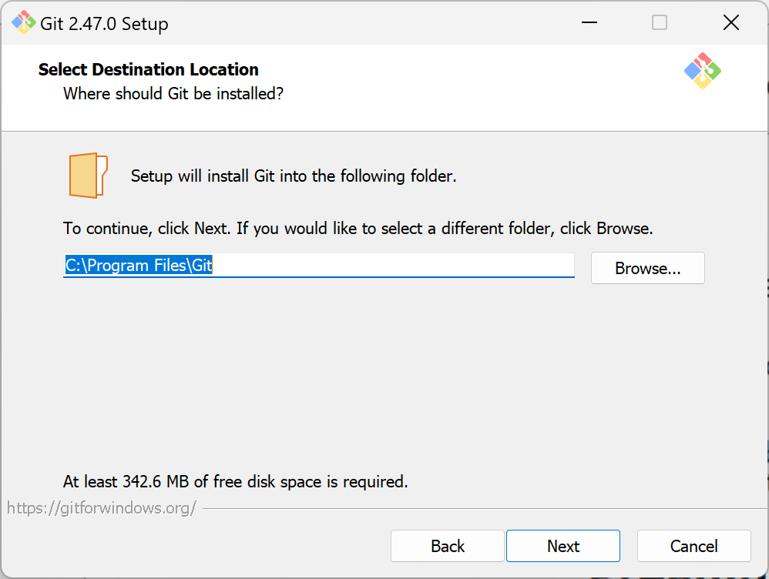

Slide 50
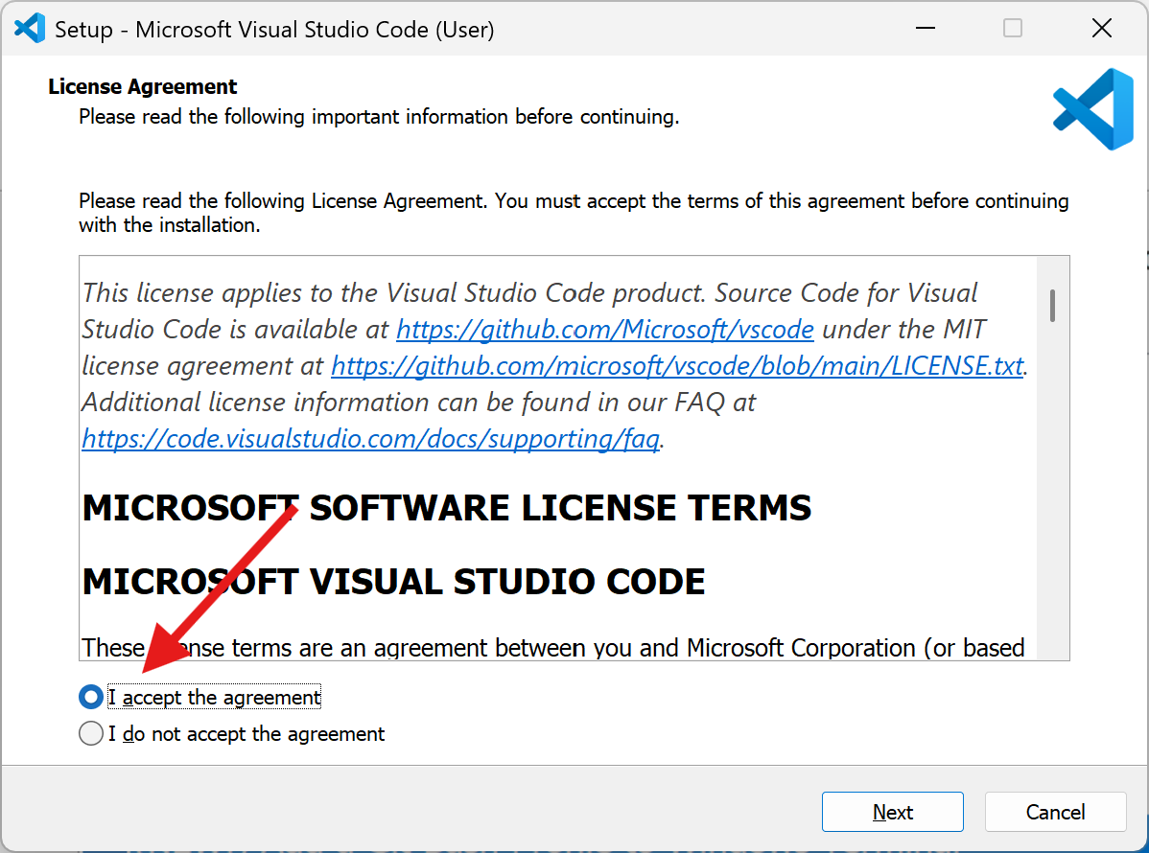

Slide 51
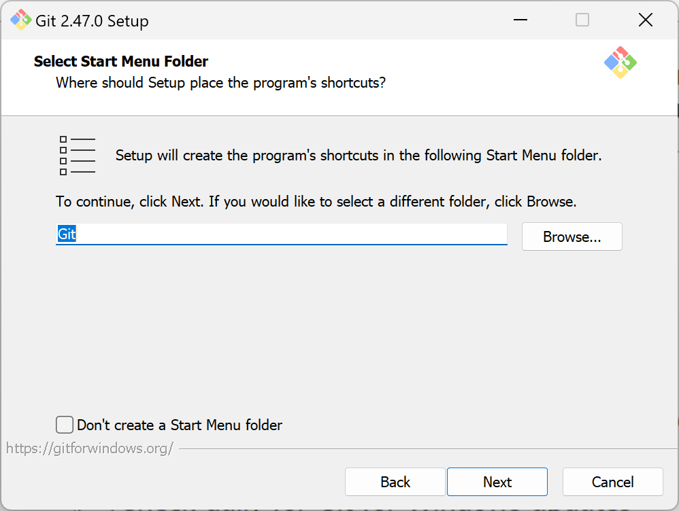

Slide 52
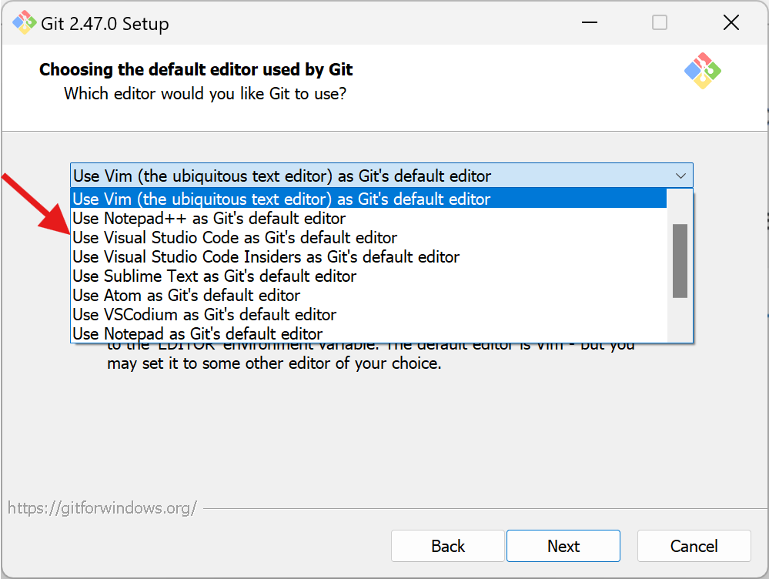

Slide 53
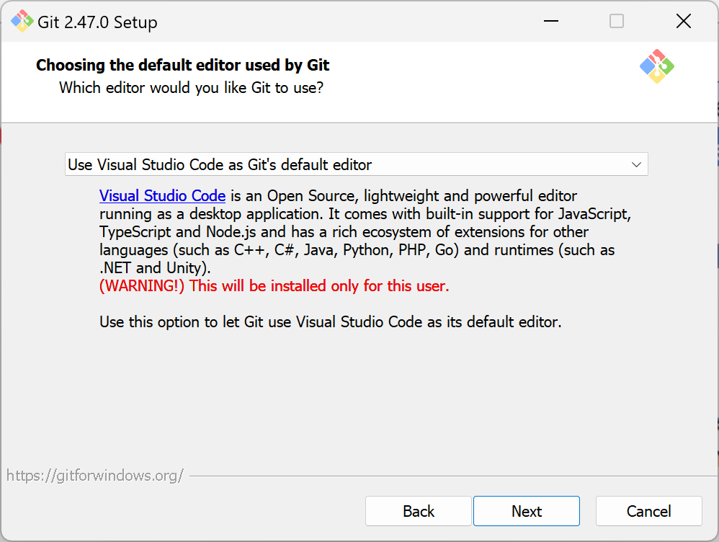

Slide 54
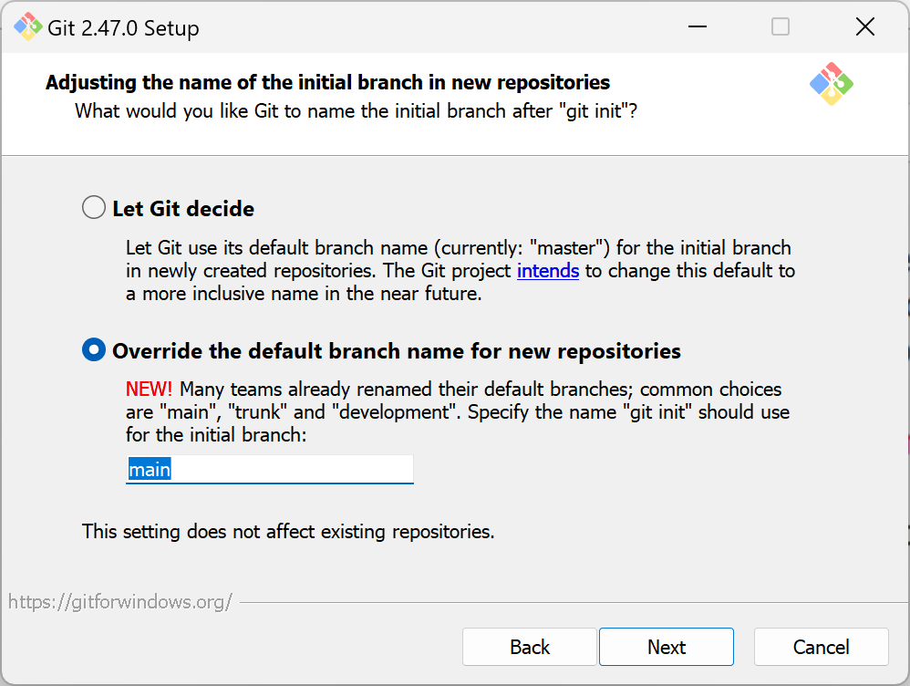

Slide 55
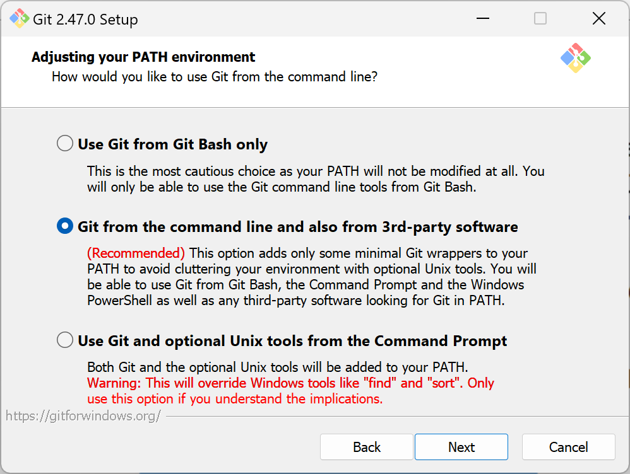

Slide 56
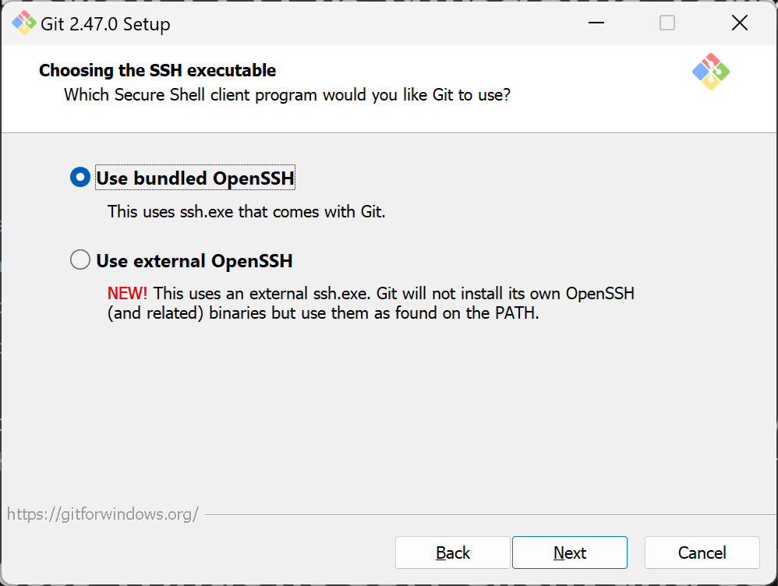

Slide 57
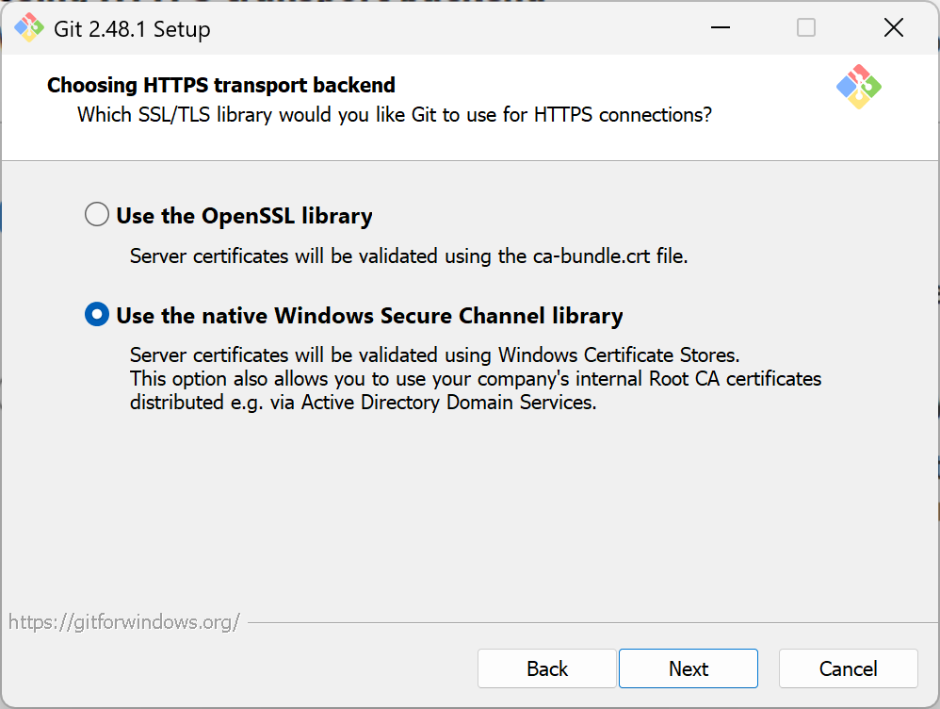

Slide 58
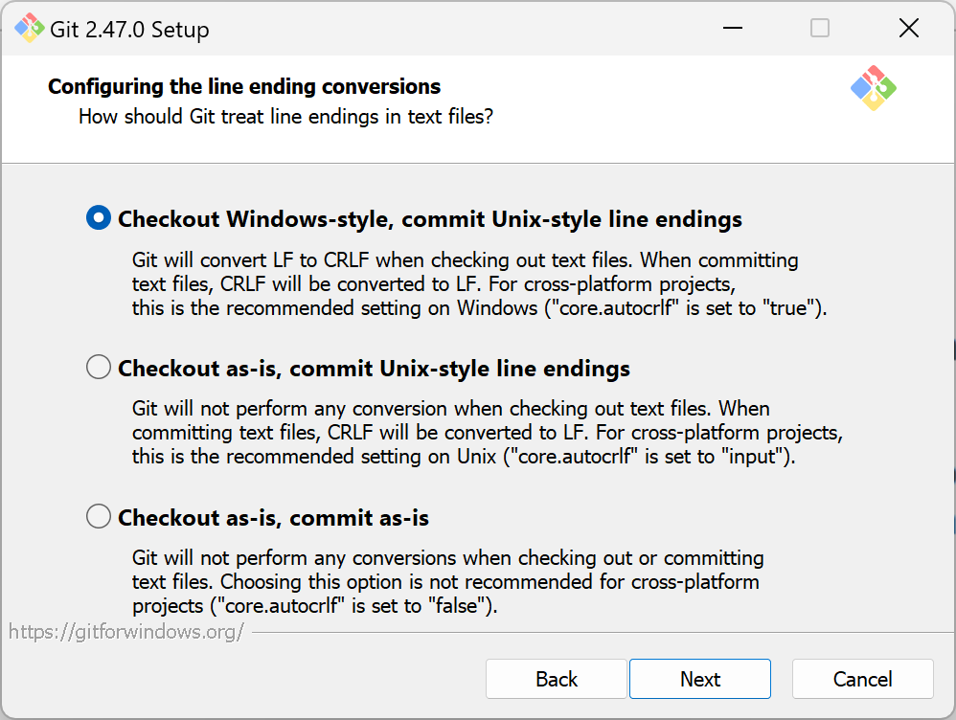

Slide 59
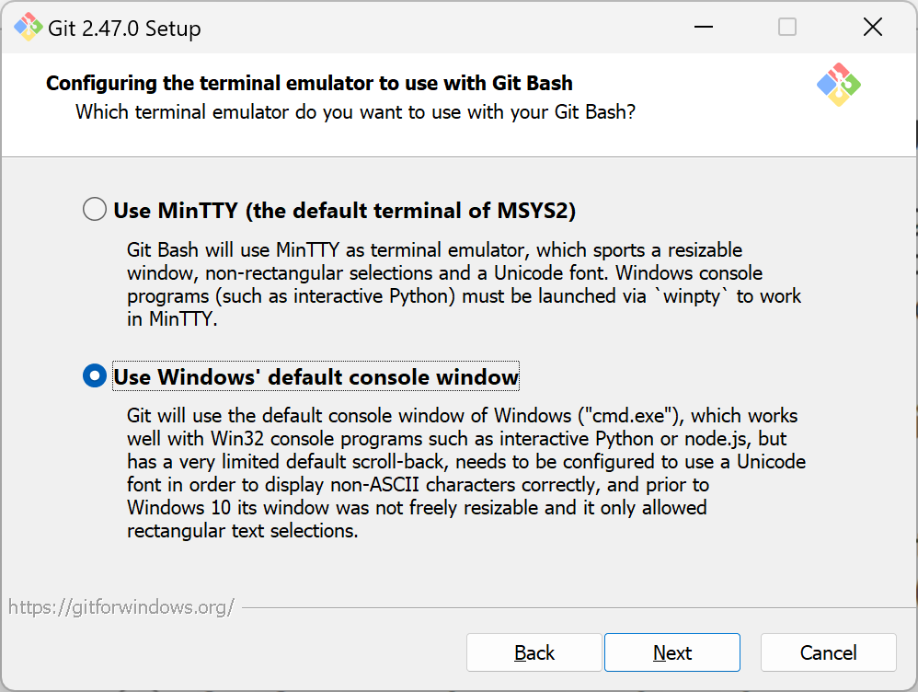

Slide 60
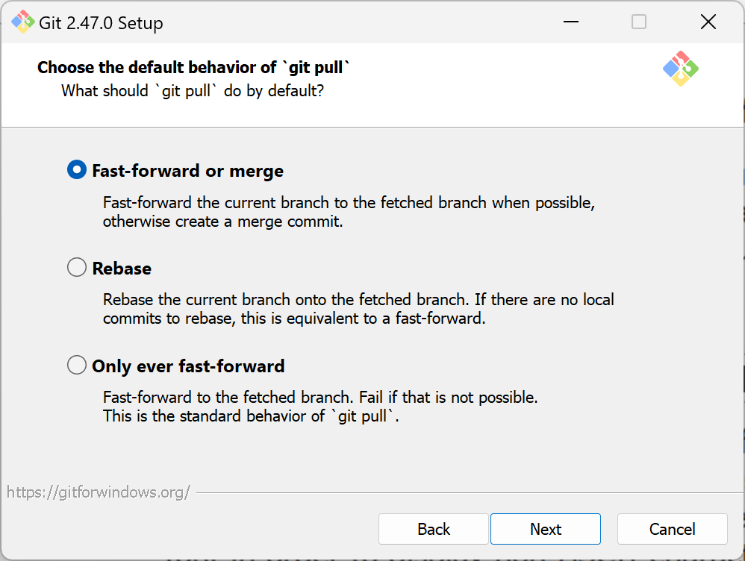

Slide 61
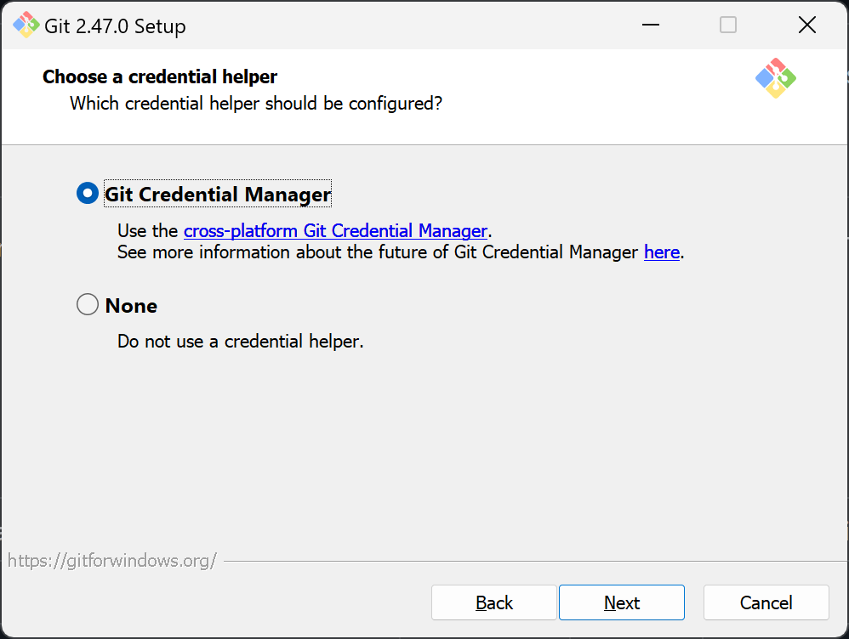

Slide 62
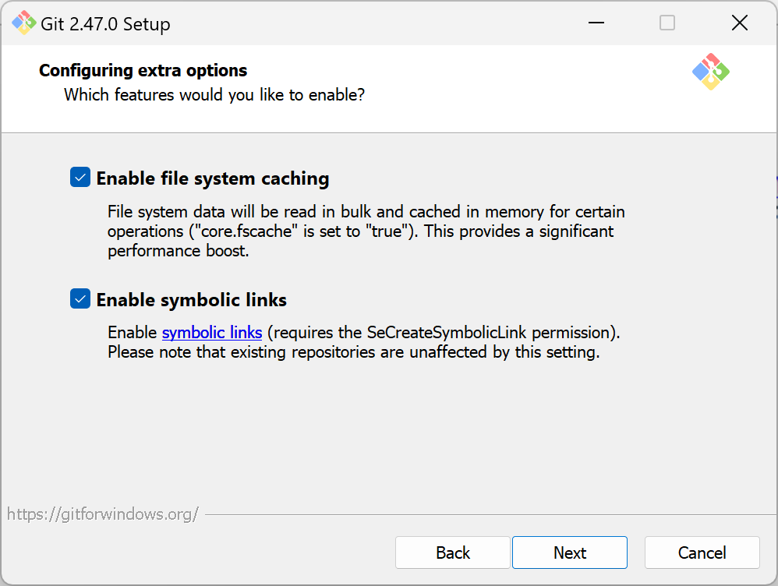

Slide 63
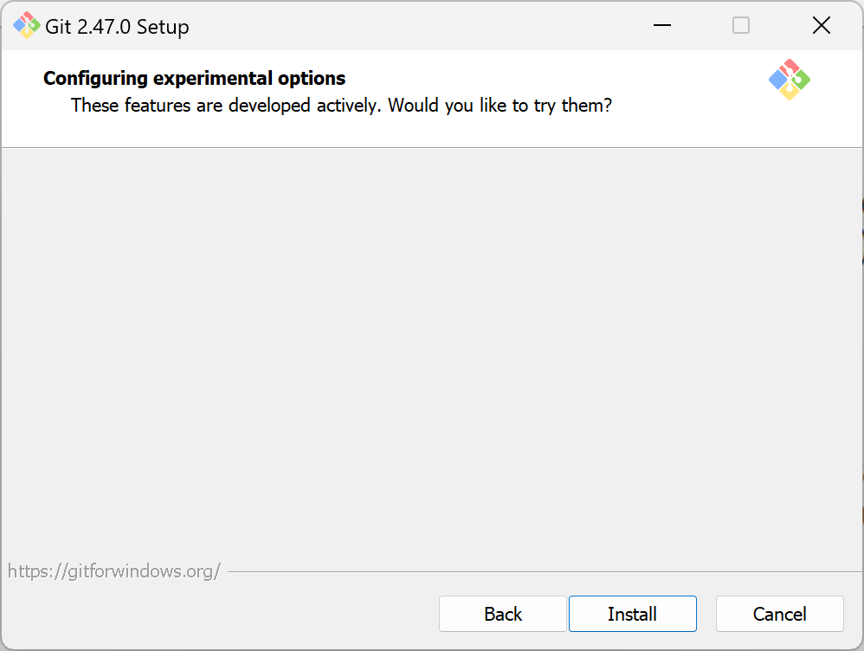

Slide 64
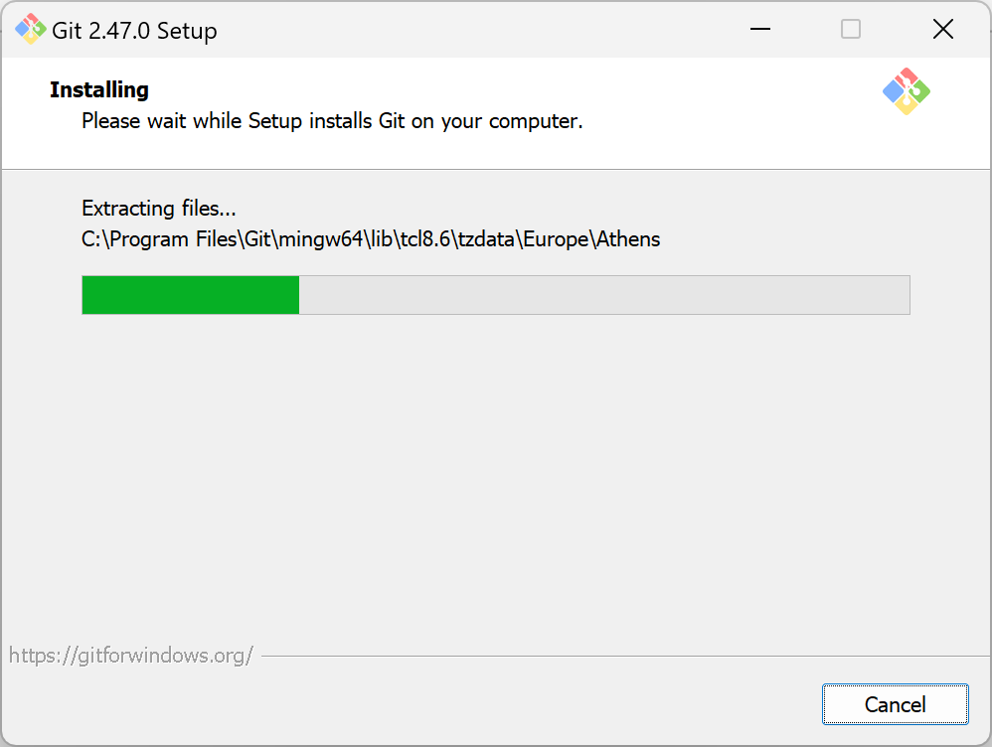

Slide 65
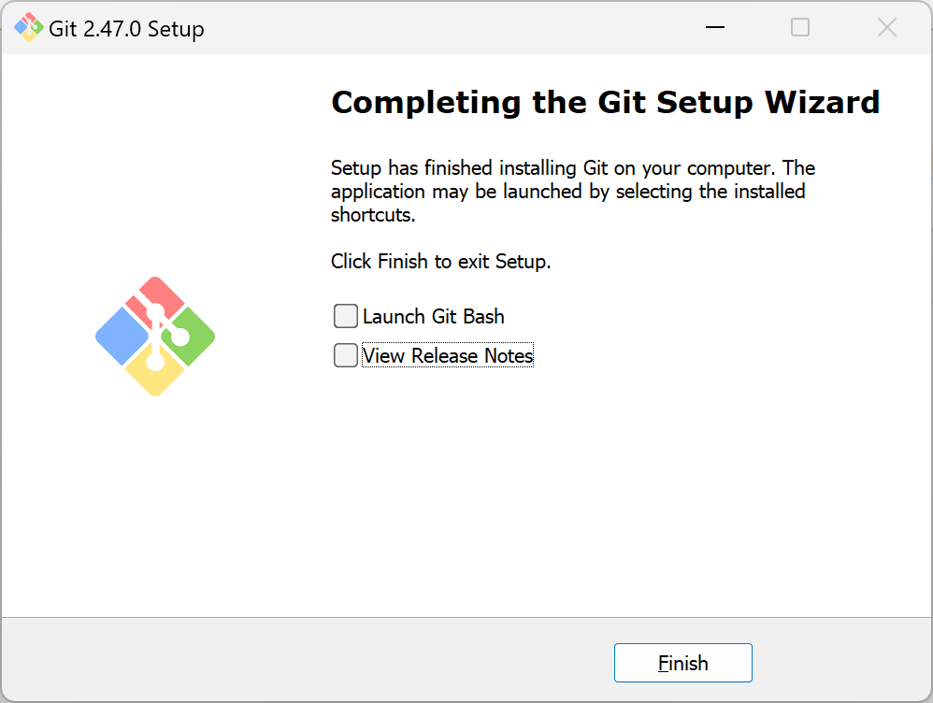

Slide 66
git terminology and concepts
repository / repo: the directory of the project you are working on, with a .git folder
commit: (noun) a version / snapshot of the repo; (verb) to create a commit
branch: (noun) a named series of commits; (verb) to create a branch
  the latest commit on a branch is the HEAD
  a default branch is the branch where most of your branches branch from, and get merged into
remote: a reference to another repo, commonly used for forks and for online hosts (e.g. GitHub, GitLab)
tag: a named commit, usually used for versions or releases
commands: instructions for git to perform some action related to version control, e.g. adding some files to the staging area, creating a new branch, checking out your colleague's branch, pushing your work to an online remote

Slide 67
git terminology and concepts
working tree: the current state of your repo
hash: a calculated signature of a commit or object
staging area / index: your plan on what to add to the commit, such as the file changes and message associated to this commit
tracked / untracked: tracked files are files that you added to git; untracked files are files that you have yet to add to git or removed from git
modified / unmodified: modified files are tracked files with changes to them; unmodified files are tracked files without changes
merge: merging changes on another branch on to another branch
.gitignore: a file that git uses to ignore certain files and directories

Slide 68
(common) git commands
git status shows you the status of your working tree
git log shows you the commit history of the current and related branch
git log --all --pretty --oneline shows you the history with a graph and all branches (not only ones related to your current working tree)
git add <file> adds files that you want to commit and track to the staging area
git commit -m <message> makes a commit with a message associated to it
git switch <branch-name> changes your working tree to the branch
git switch -c <branch-name> creates a new branch and switches to it
git fetch fetches status from the origin remote
git push updates the remote with changes from your local repo
git pull updates your branch with changes in remote
git clone <remote> copies a repo from a remote on to your machine

Slide 69
Hands-on git
Notes:
Install git for windows

Slide 70
Set up a Spring 2025 Python project
Create a folder somewhere named redi-s25-python (something similar). It will be easier if you don't use spaces and use dashes – or underscores _ instead!
Open the folder in VSCode
  Right click the folder and "Open in VSCode"
  Open VSCode, and open the File Menu, then Open Folder, then search for your folder
Open the Integrated Terminal (Ctrl + `)
Run git init to initialize (set up) the folder as a git folder
Set up your local git account
  git config --global user.email "you@example.com"
  git config --global user.name "Your Name"

Slide 71
Set up a Spring 2025 Python project
Set up your local git account
git config --global user.email "you@example.com"
git config --global user.name "Your Name"

Slide 72
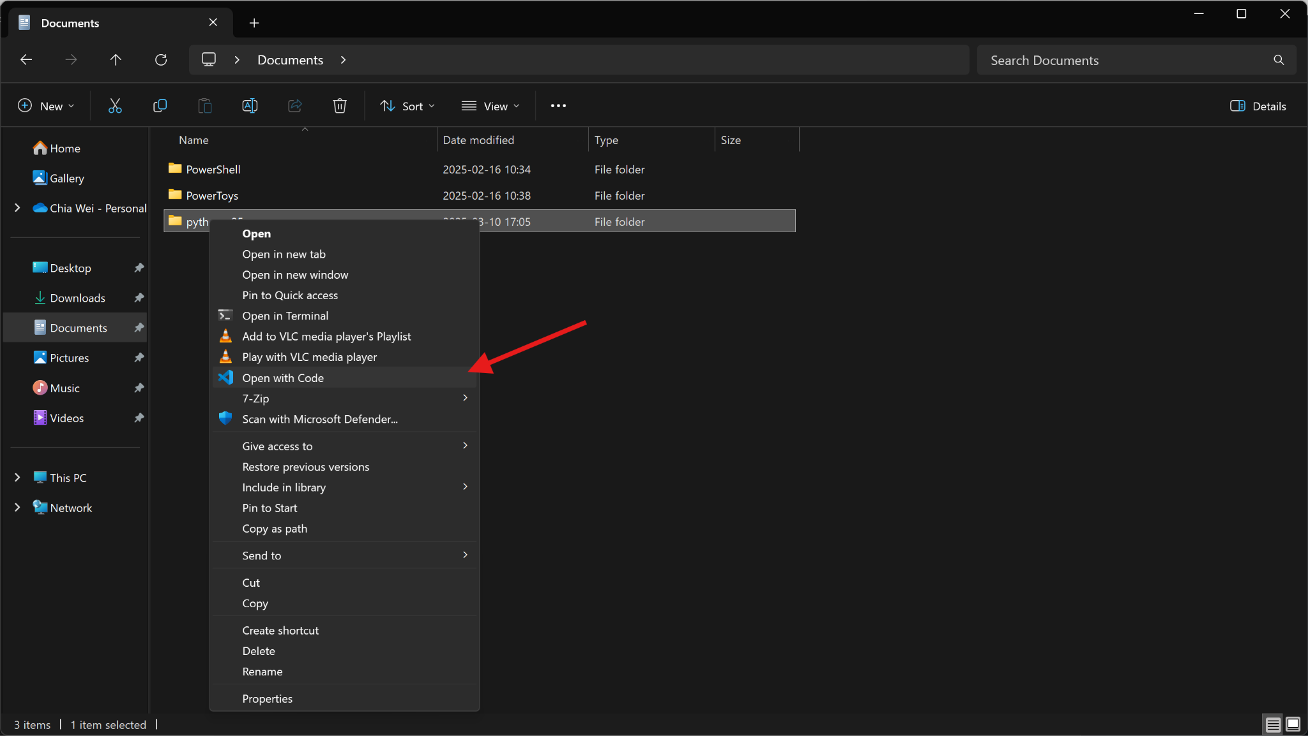

Slide 73
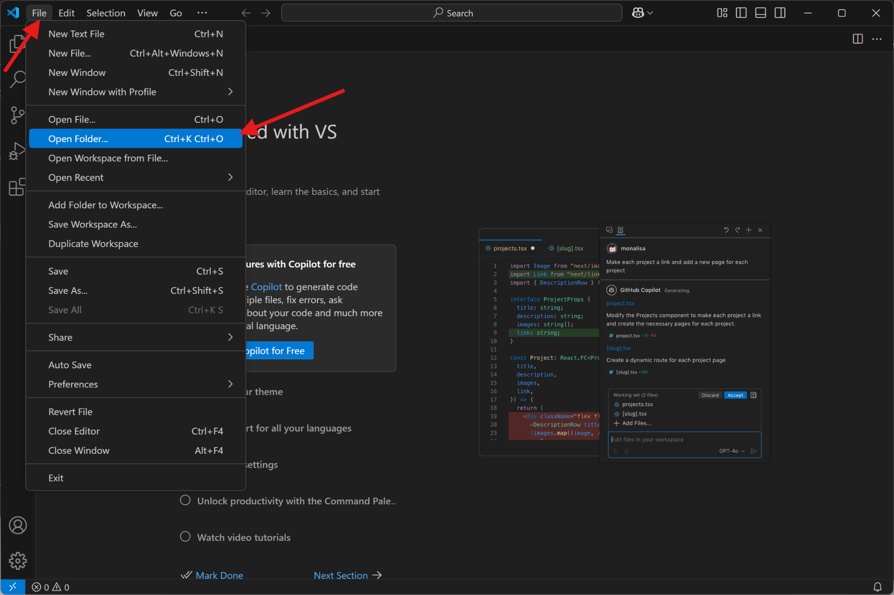

Slide 74
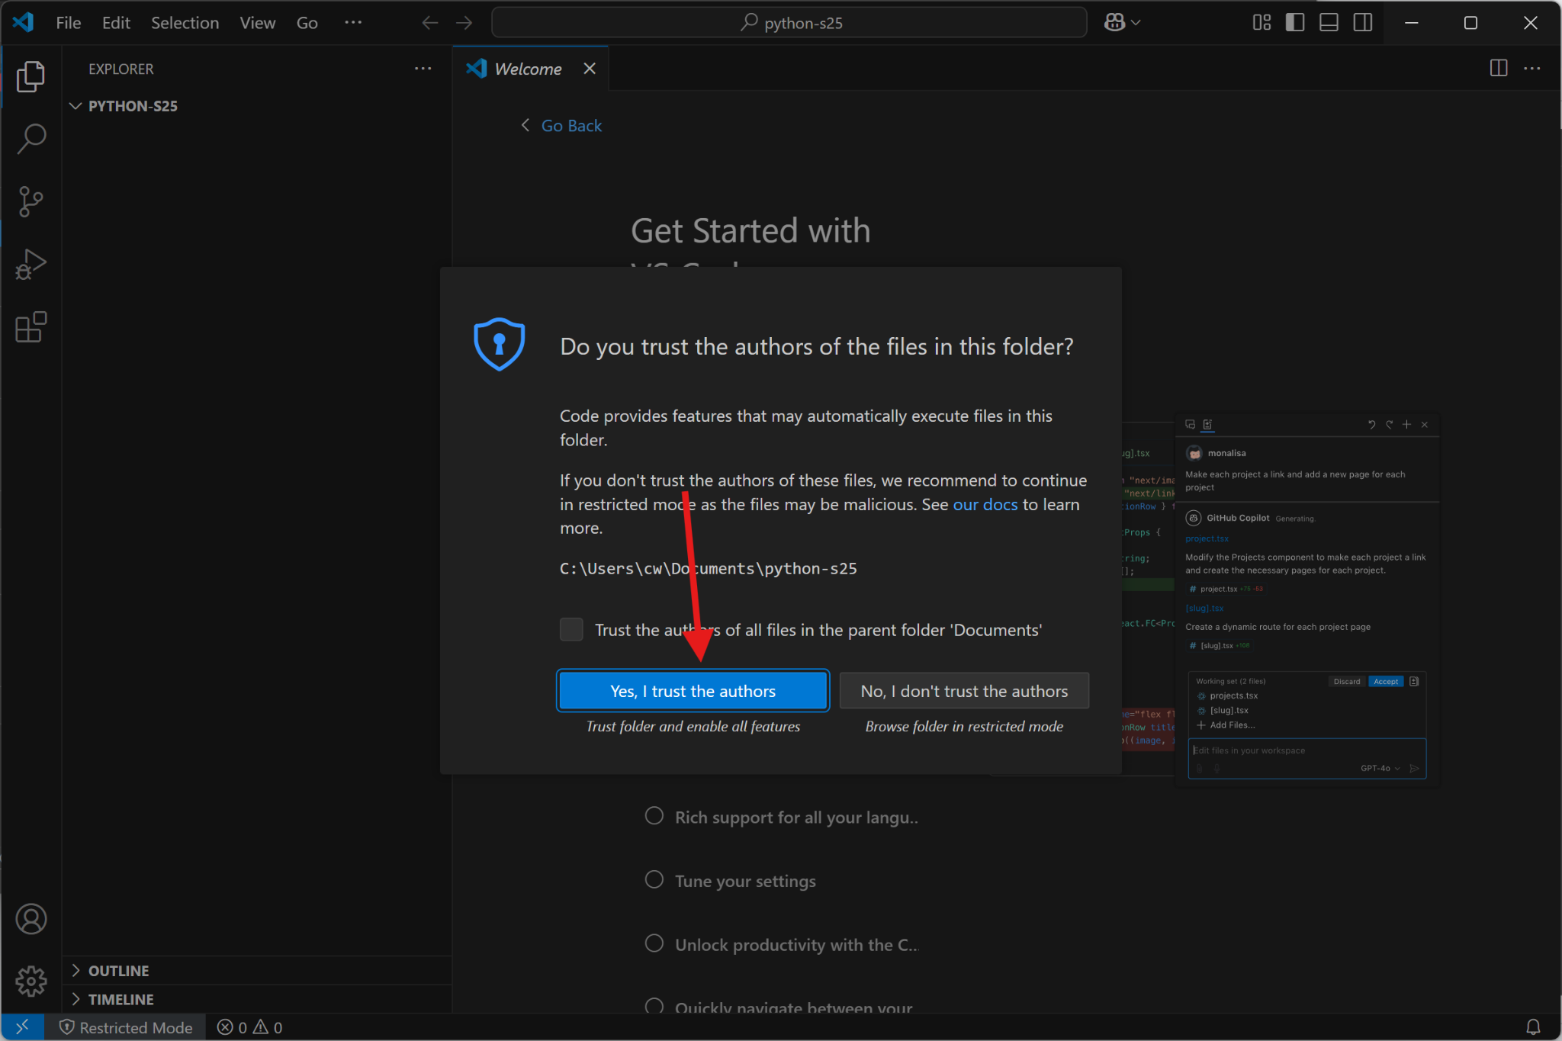

Slide 75
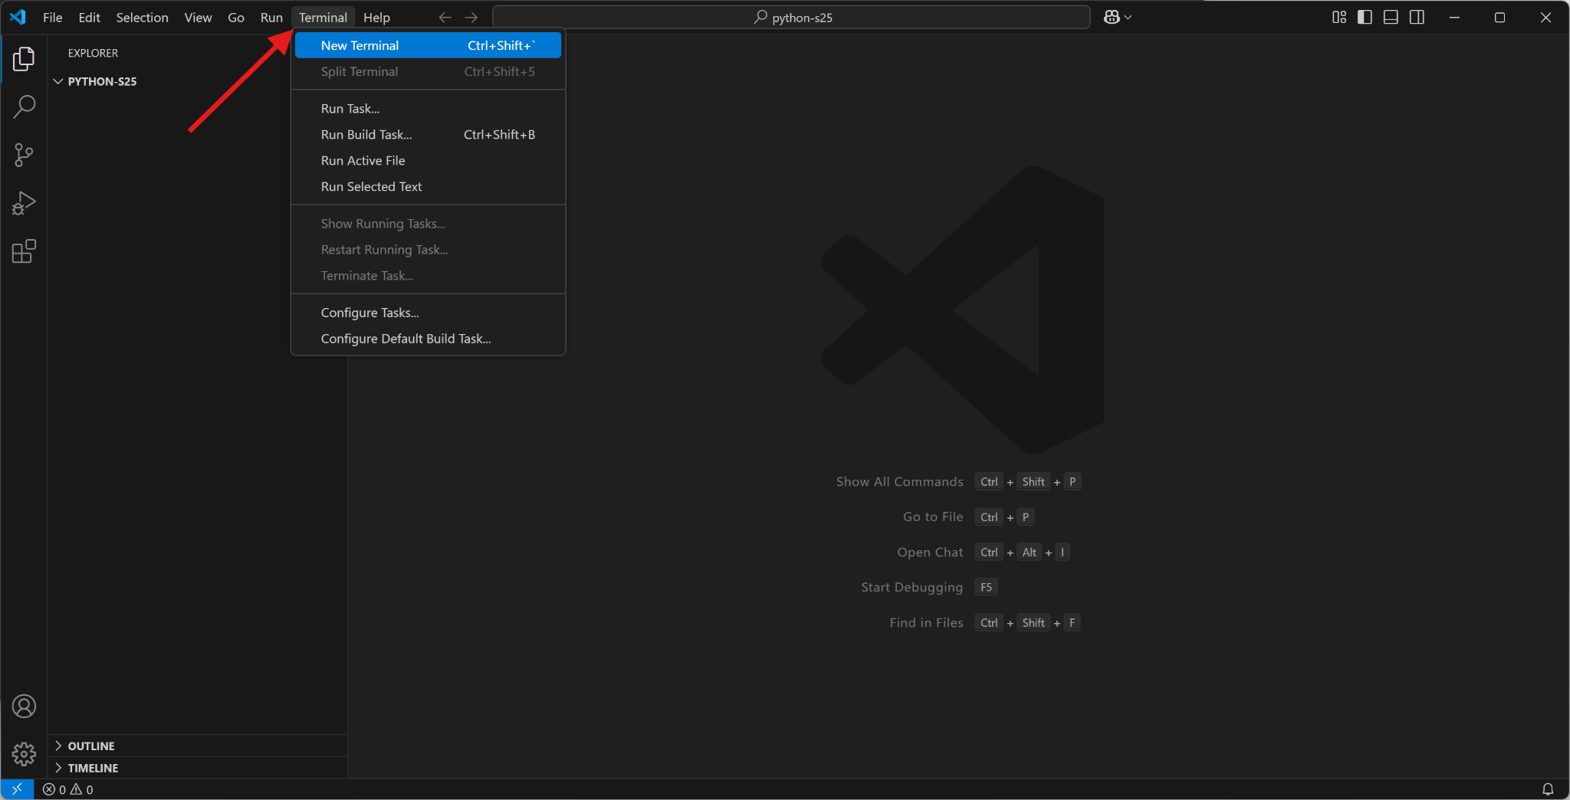

Slide 76
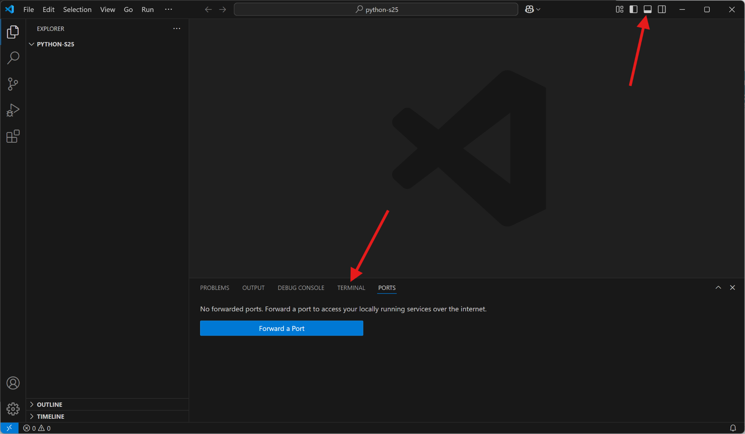

Slide 77
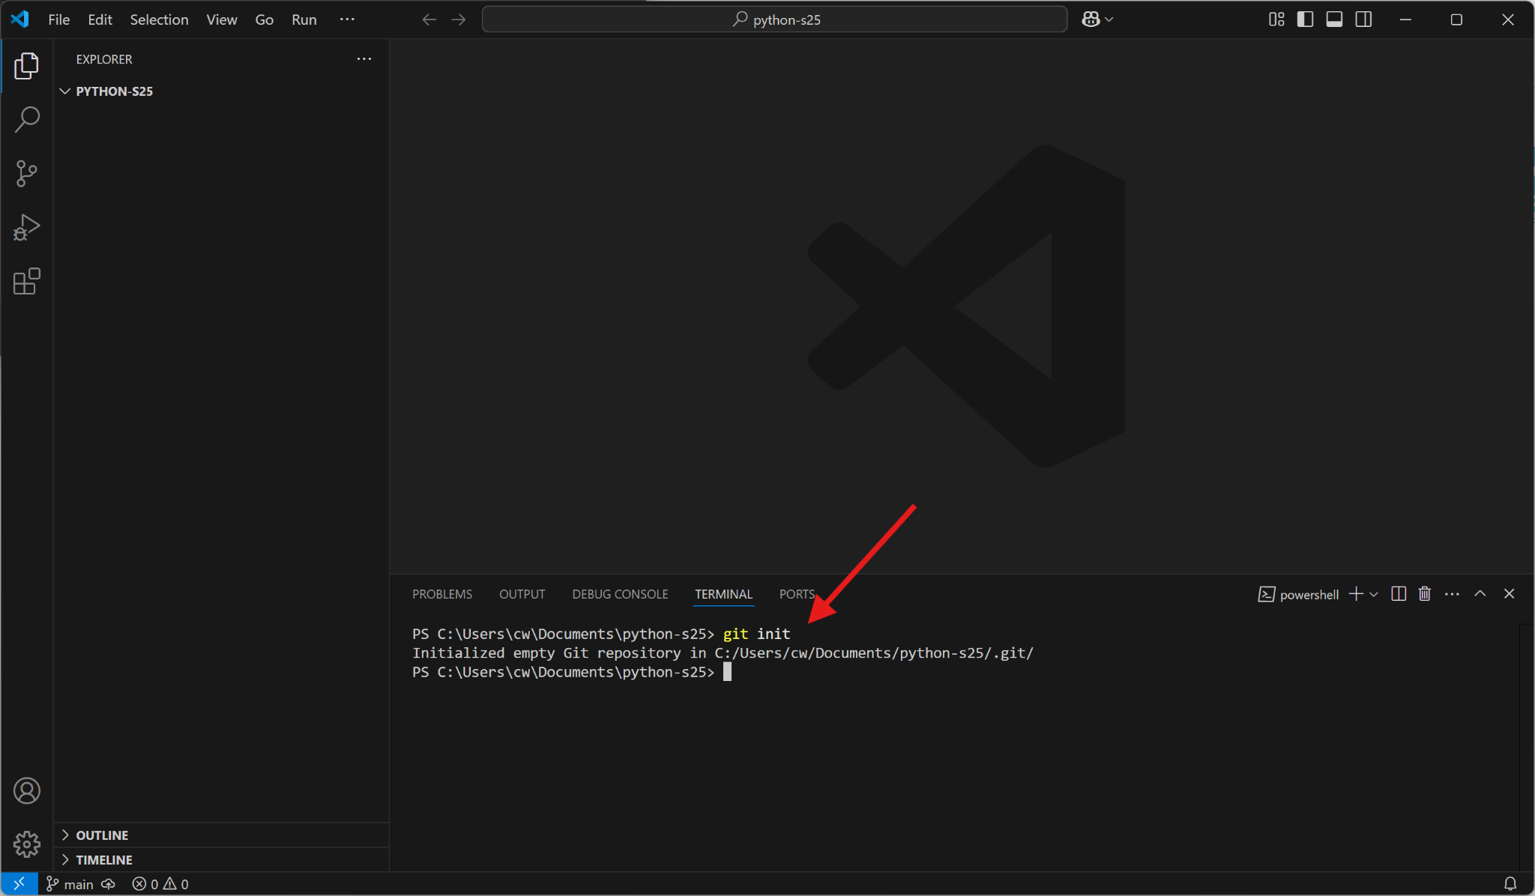

Slide 78
Set up a Spring 2025 Python project
Link your local git with GitHub
  Go to your GitHub account and create a repository
  Copy and paste the commands on the empty repository page
  Login through your browser when prompted
After every class, commit and push your changes to GitHub!

Slide 79
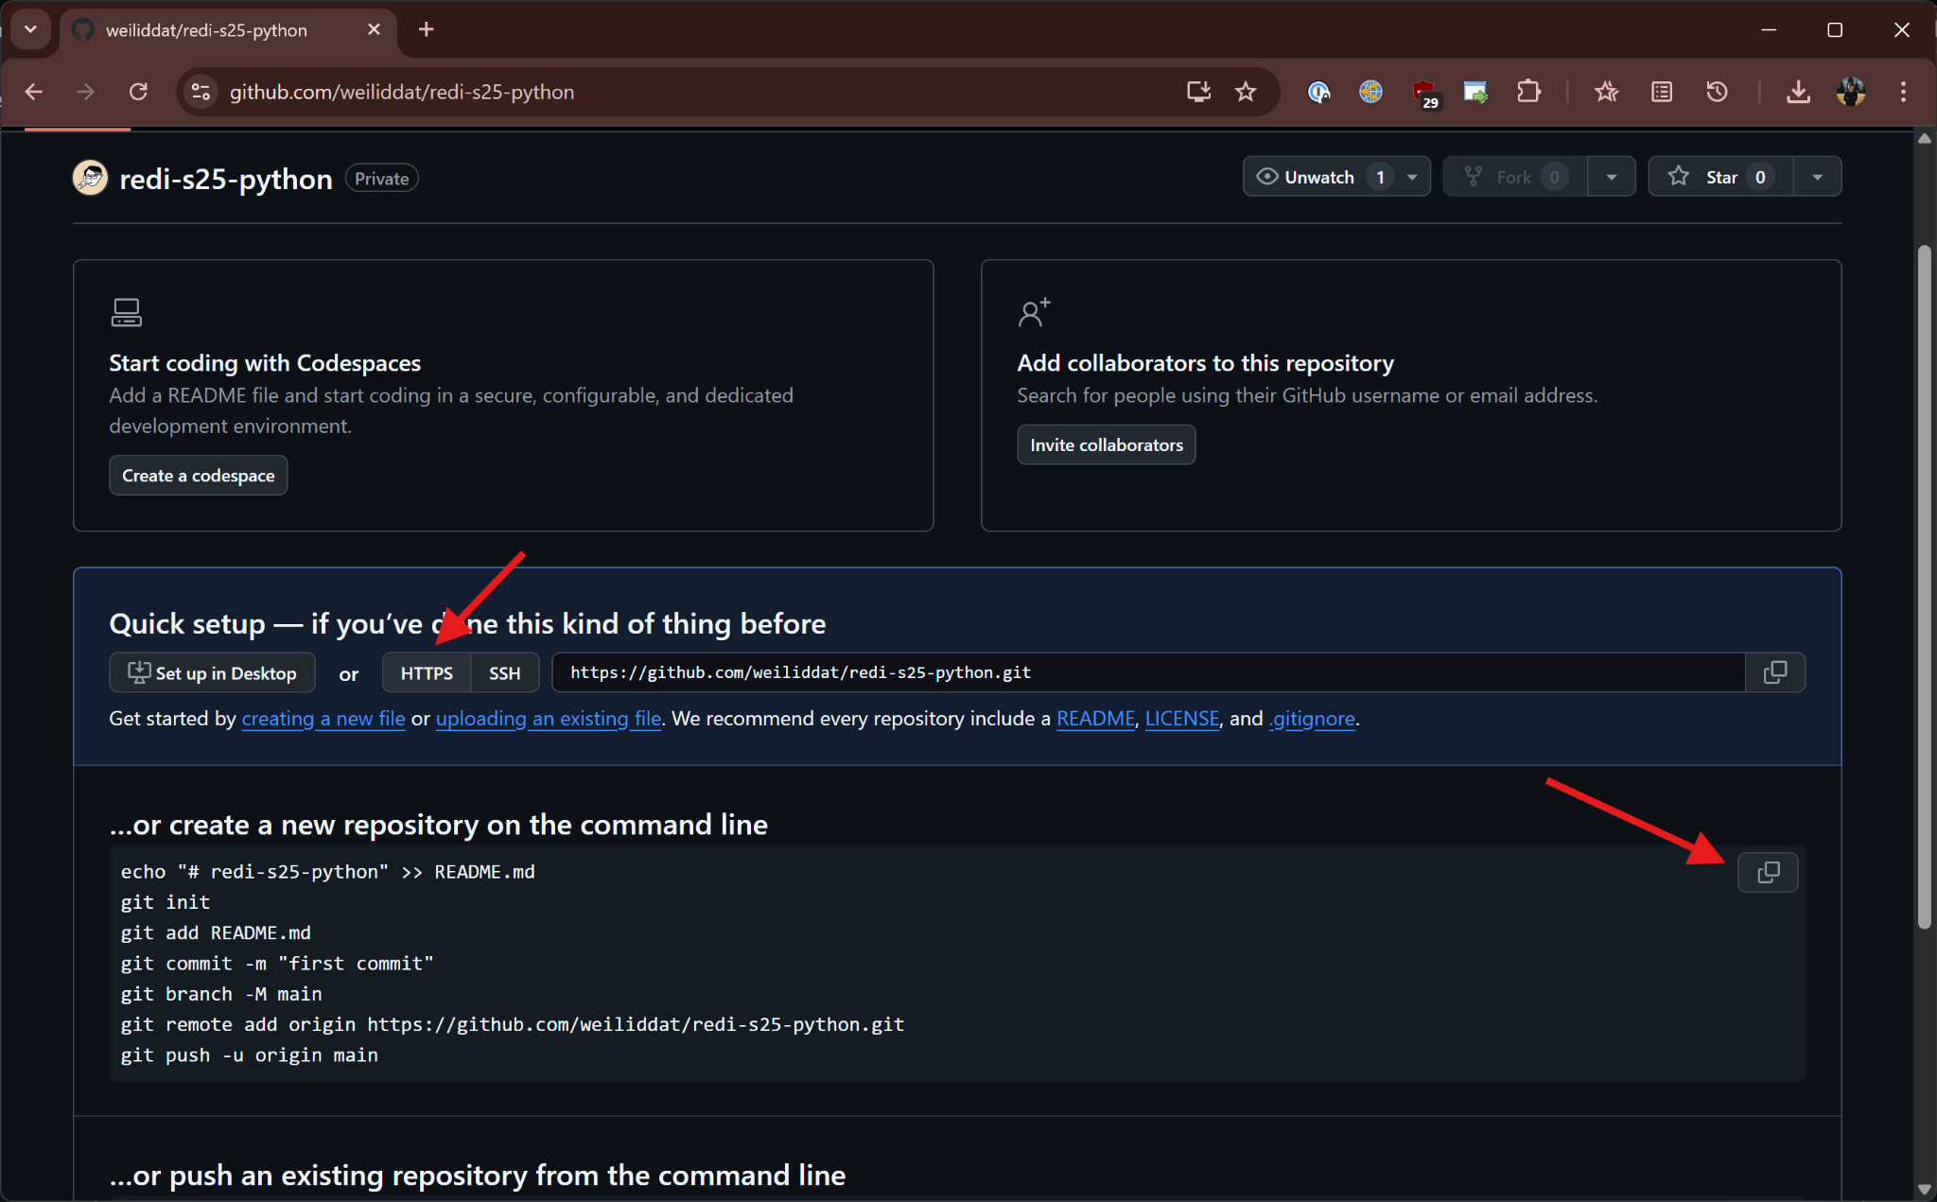

Slide 80
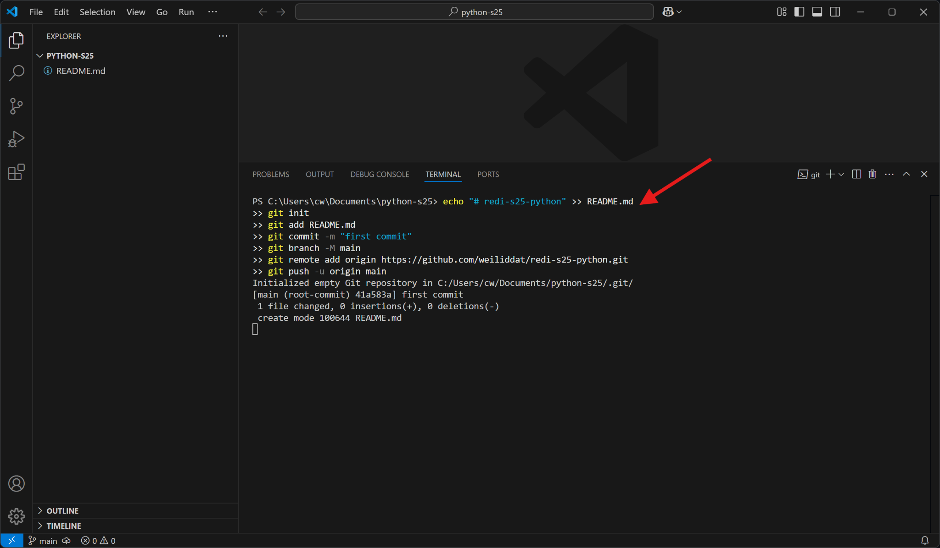

Slide 81


Slide 82


Slide 83


Slide 84
Homework

Slide 85
Feel free to look at
Articles about what you can do with python
  https://realpython.com/what-can-i-do-with-python
  https://www.futurelearn.com/info/blog/what-is-python-used-for
Official python tutorial, chapters 1-3
  https://docs.python.org/3/tutorial/index.html
A python game (it’s for kids, but it’s actually fun)
  https://www.codemonkey.com/courses/banana-tales/
Stack Overflow
  https://stackoverflow.com/
PyPi
  https://pypi.org/

Slide 86
git references / guides
https://githubtraining.github.io/training-manual
https://training.github.com/downloads/github-git-cheat-sheet/
https://ohshitgit.com/
https://git-scm.com/book/en/v2

Slide 87

Before you go…
Please take 2 minutes to give us feedback on today’s lesson.
This feedback is anonymous and only seen by the DCP team!

